Slide 1
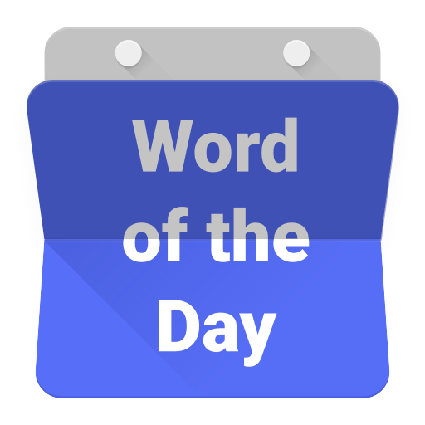

Slide 2
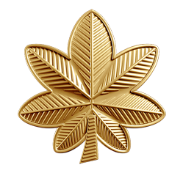
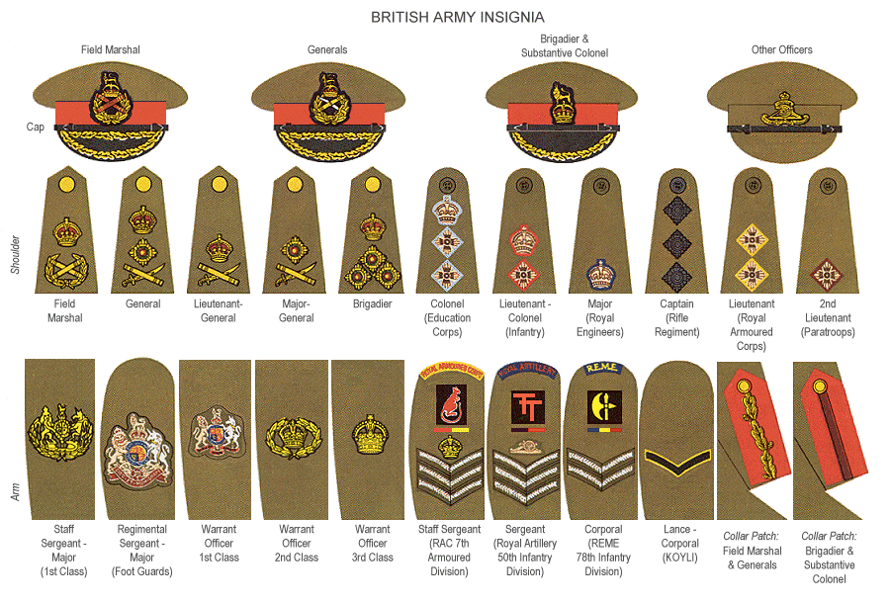
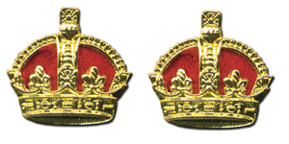
meja

Slide 3
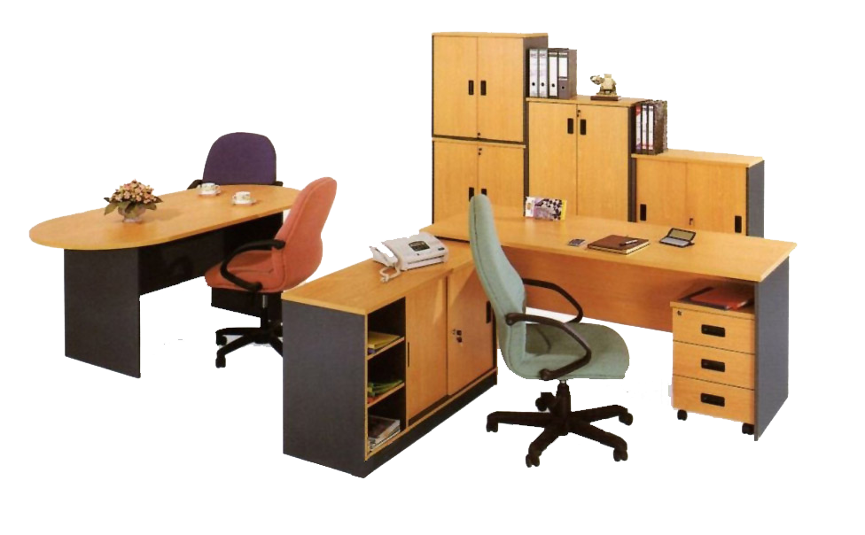
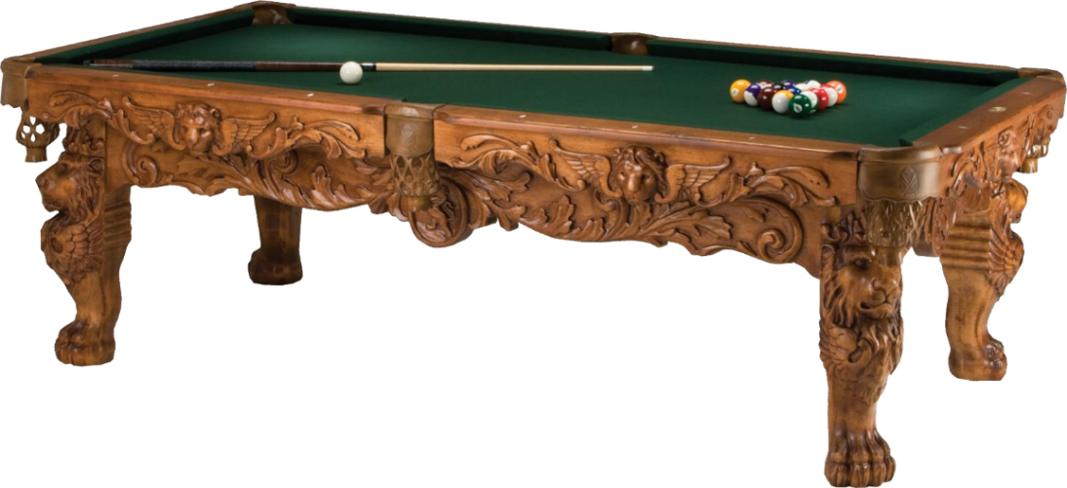
meja
From all the military insignia, you are probably thinking that the Indonesian word “meja”, pronounced “meh-jah”, signifies the rank of “major” in the US, British & Australian Armies, right ?
Sorry to turn the “tables” on you yet again, but the noun “meja” refers to any “desk” or “table” in Indonesian.

Slide 4
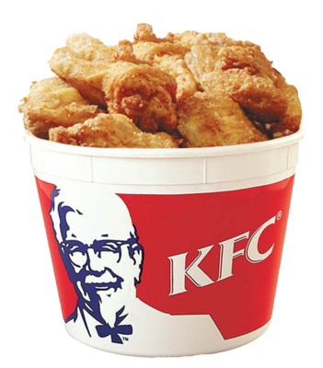
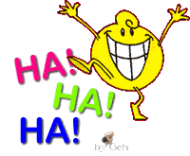
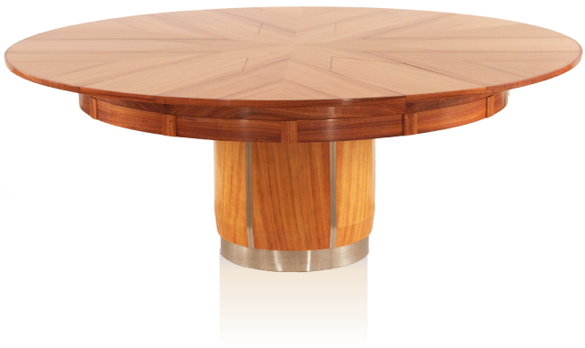
meja
If you have a successful military career you, too, can turn the “meja” on a “major” by becoming a “colonel” and outranking him! Who can forget the most famous “colonel” of all-time ? Now, he really had something special to bring to the “meja” !!!

