Slide 2
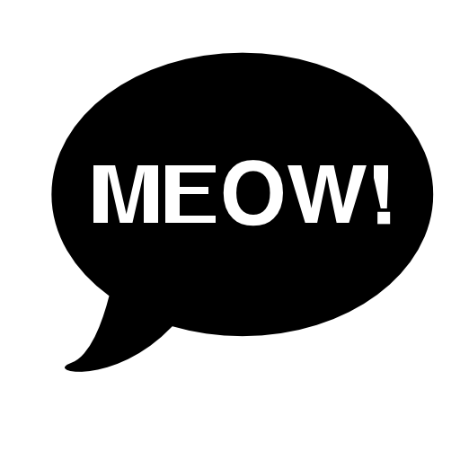
mau

Slide 3
mau
No, “mau” is not what an Indonesian cat says - unless it wants something, that is!
“mau” means “to want …” so “Saya mau …” means “I want …”!
Try offering your cat some food and see if it says, “Mau!!!”

