Slide 2
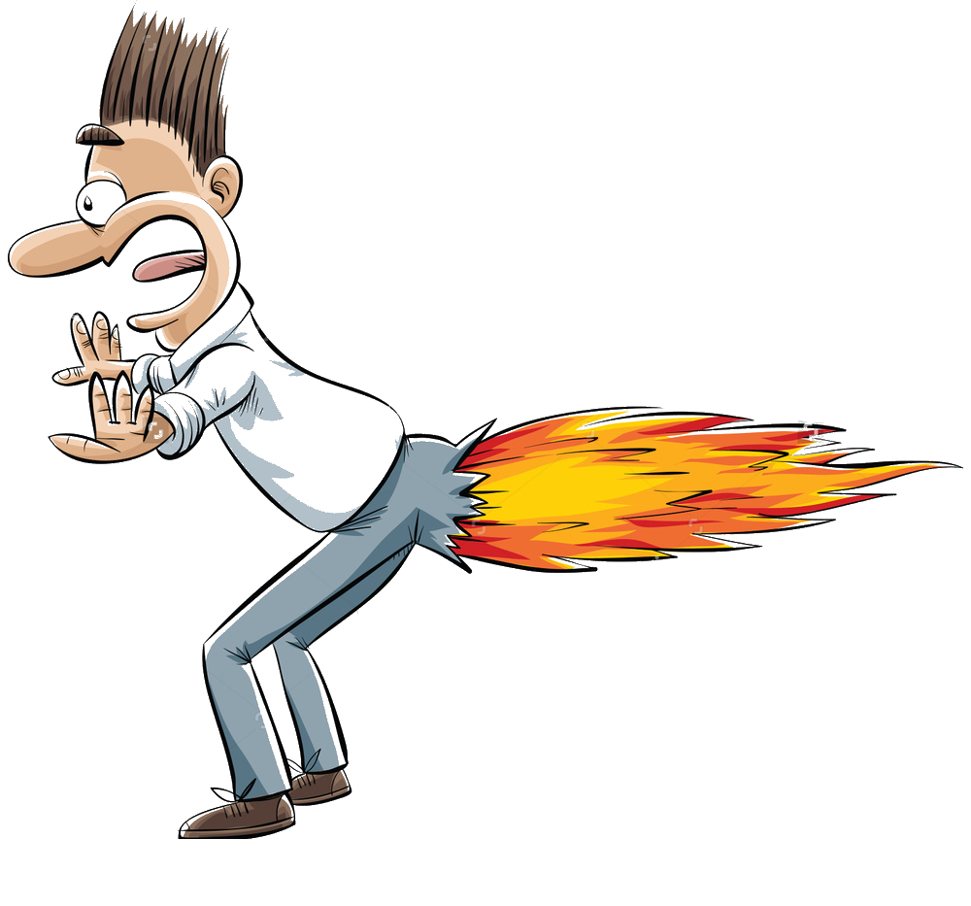
manfaat

Slide 3
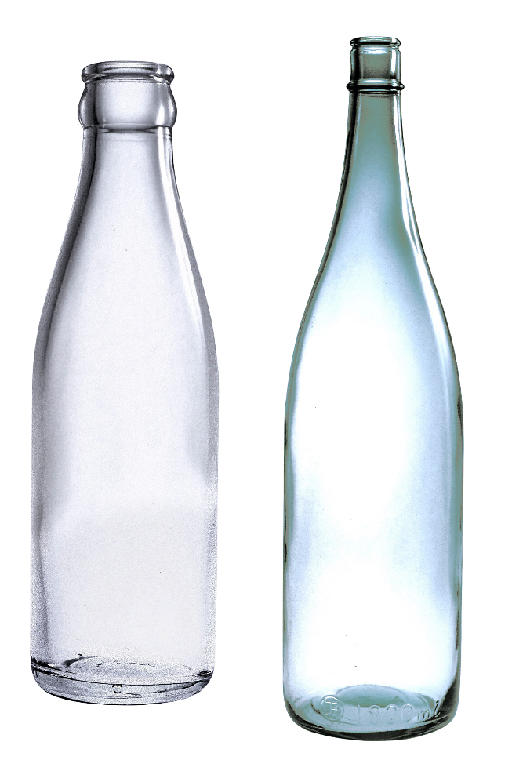
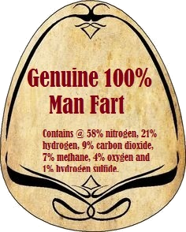
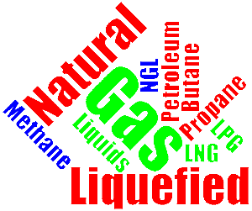
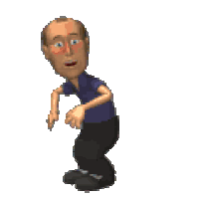
manfaat
I know what you’re thinking … “manfaat” , pronounced “mun-fah-ut”, must be a “man fart”.
Nothing could be further from the truth! “manfaat” means “to benefit from” or “to take advantage of” something.
Considering it contains a number of flammable gases, there could be a business opportunity if you “manfaat” a man-fart by bottling it and selling it to power companies for electricity generation.

