Slide 2
main

Slide 3
main
You could be excused for thinking that “main”, pronounced “mah-in”, is the Indonesian word for “main”.
The “main” point here is that “main” does not mean “main”.
The verb “main”, which is short for “bermain”, means “to play …” in Indonesian.

Slide 4
main
By using the structure “main” + ACTIVITY you can say what activities or sports you like to “do” or “play”.

Slide 5
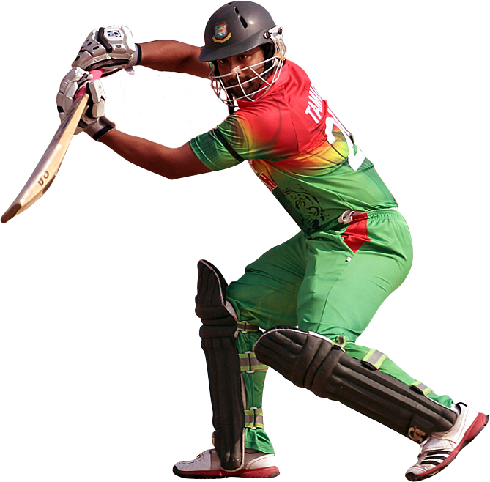
main
If you become exceptional in an activity or sport, you could become a “main” event player!

