Slide 2
lisan

Slide 3
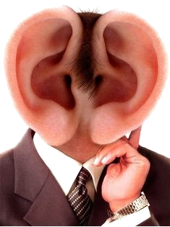
lisan
You are probably thinking that “lisan”, pronounced “liss-un”, is the Indonesian word for “listen”, right?
If that’s the case, you need to “lisan” up while I explain that the adjective “lisan” means “oral”, “spoken” or “verbal” with regards to language in Indonesian.
Keep on talking … I’m all ears!!!

Slide 4
lisan
When learning a language we learn to listen and speak (oracy) before we learn to read and write (literacy).
The skills of oracy are vitally important in communicating so you need to “listen” as well as “lisan” to succeed in Indonesian!

