Slide 1
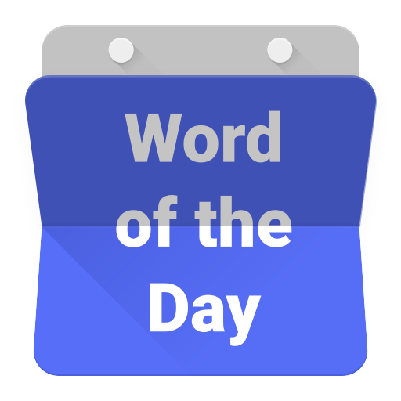

Slide 2
lidah

Slide 3
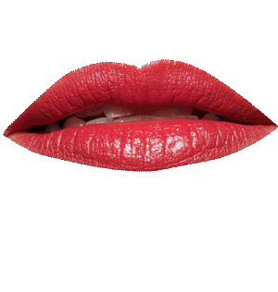
lidah
Wait a moment, the WORD of the DAY is “lidah”, not “leader” !!!
The Indonesian noun “lidah” (pronounced “lid-ah”) is the word for “tongue”.
The question on the tip of everybody’s “lidah” at the moment is whether Donald Trump can become “leader” of the United States of America???
Many non-Americans are hoping that Hillary Clinton will give him a good licking in the upcoming presidential election.

Slide 4
God Bless America

