Slide 2
layar

Slide 3
layar
You are probably thinking that “layar” , pronounced “lie-are”, means “liar” in Indonesian, right?
Well, let me tell you, nothing could be further from the truth!
As you can see, my nose hasn’t grown nor have my pants caught fire!

Slide 4
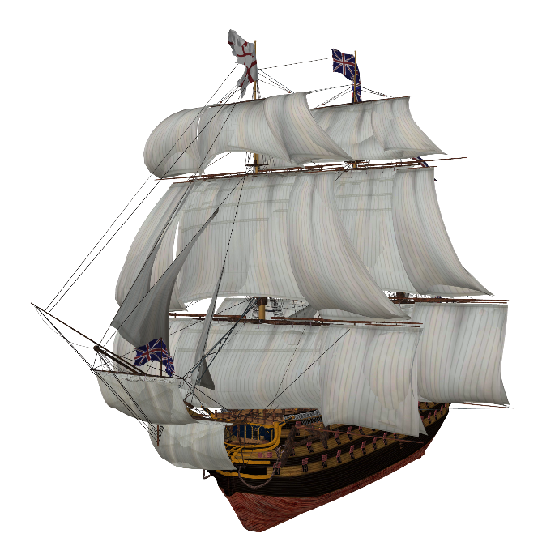
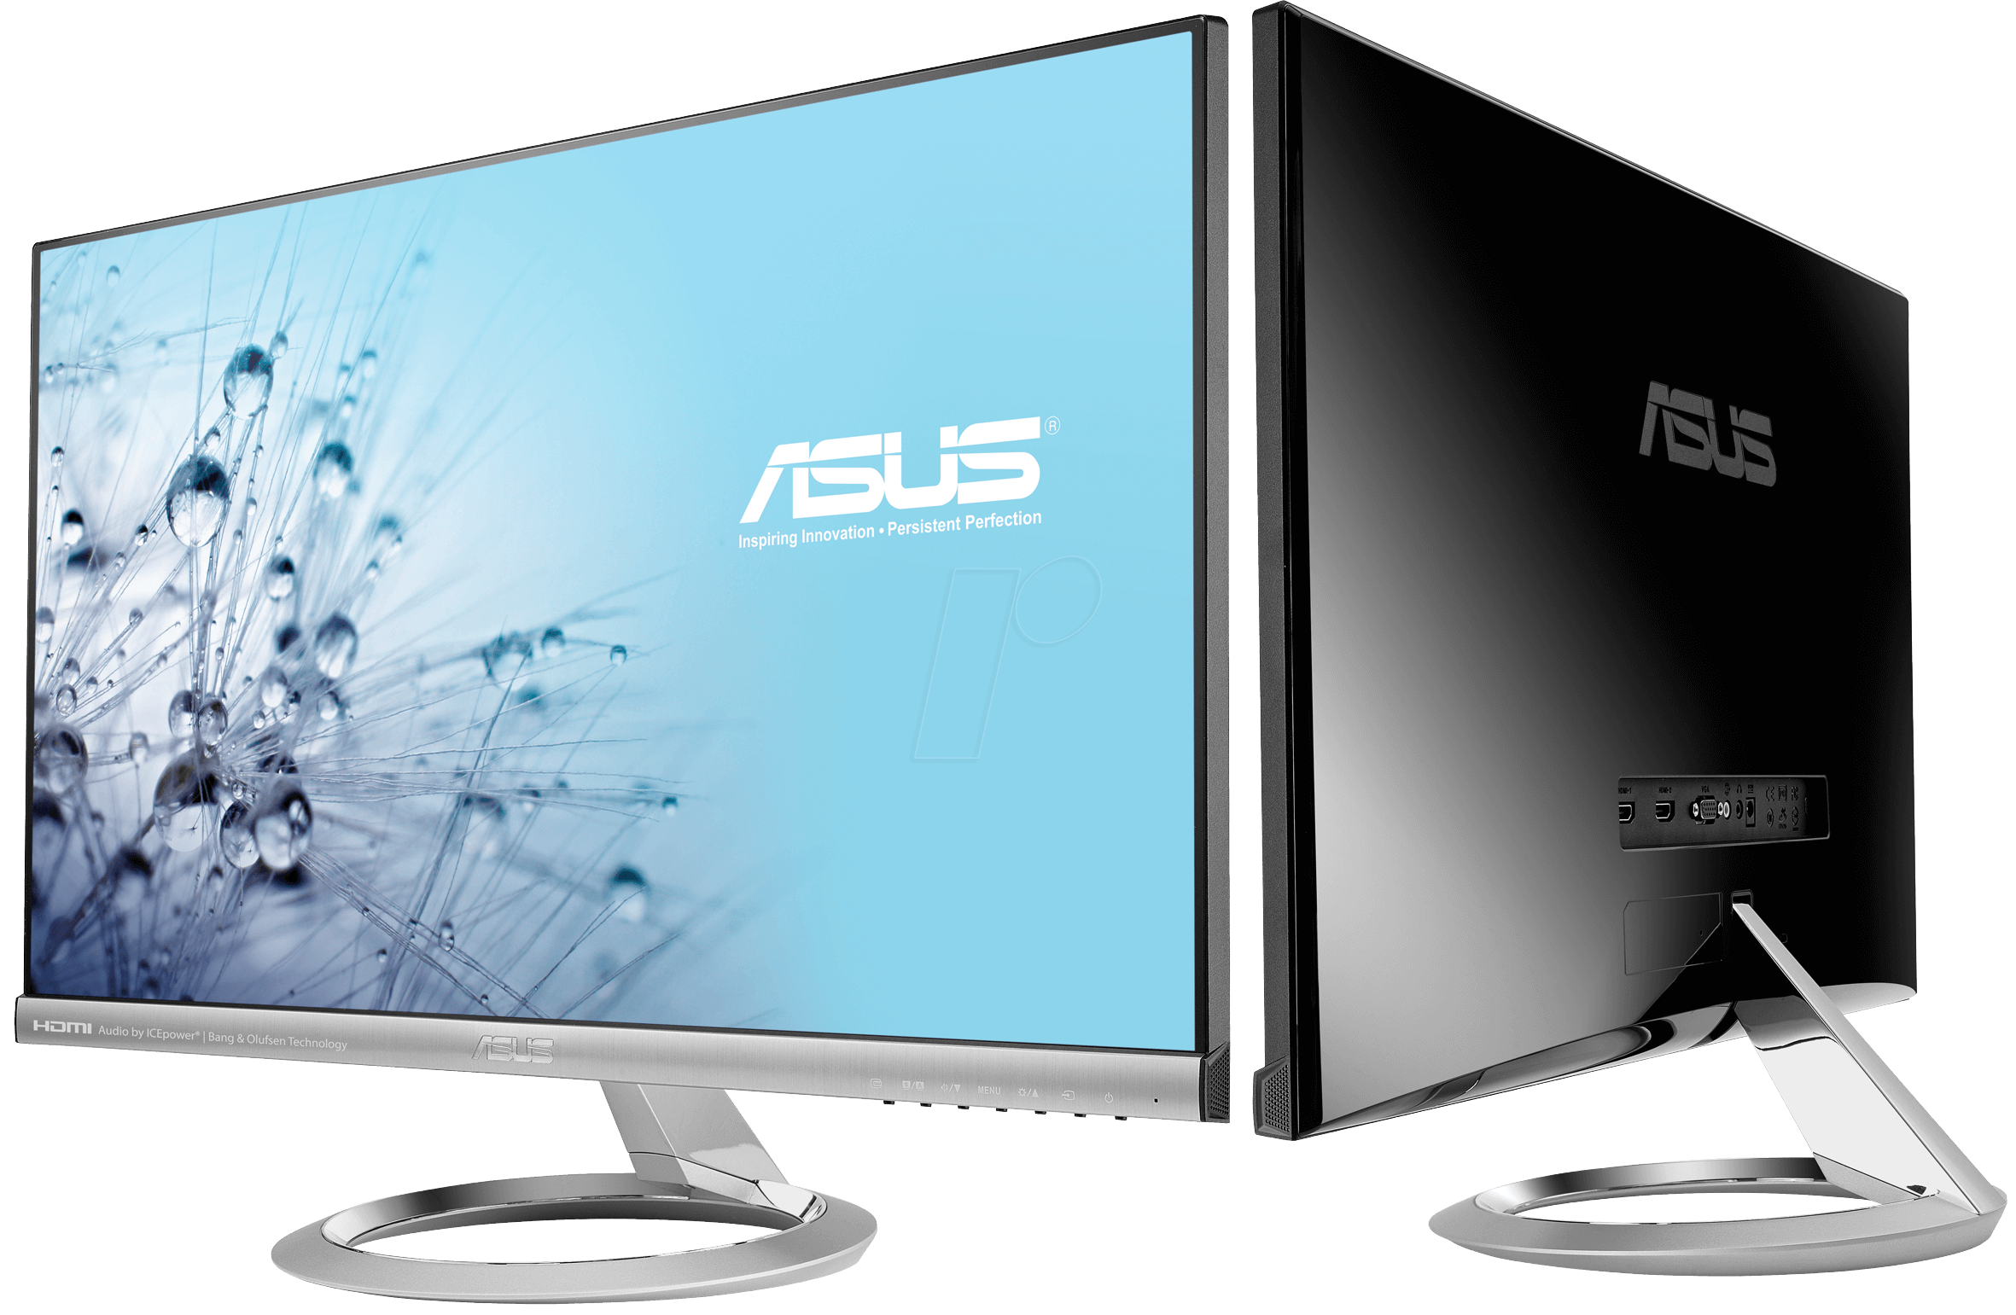
layar
The noun “layar” is used to name any kind of “screen” or “sail” in Indonesian.

Slide 5
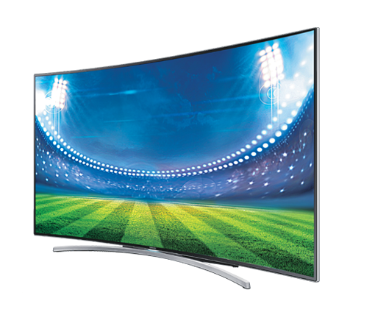
layar
I wouldn’t be a “liar” if I told you that you could purchase a very advanced “layar televisi” at a “sale” for a very decent price these days.

