Slide 2
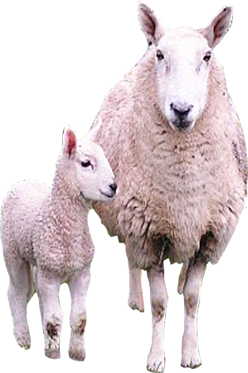
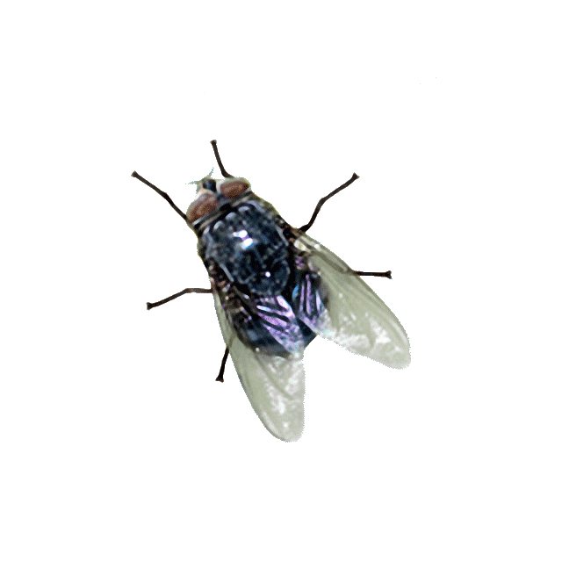
lampu

Slide 3
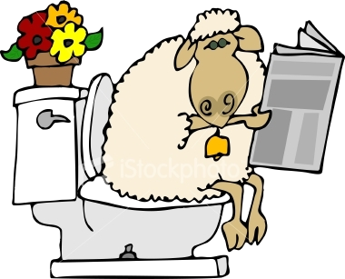
lampu
I know what you’re thinking … “lampu” must mean “lamb droppings” or “ sheep poo”. Well, I’m sorry to disappoint you, but I’m not into toilet humour!
The word “lampu”, pronounced “lum-pooh”, is any “lamp” , “light bulb” or “fluorescent light”.
I hope that throws some “light” on the subject.
If you’re wondering why the flies are still here, they’re just attracted to the “lumpu” !

Slide 4
lampu
You must think you’re a real bright spark! Well let me tell you something, Mister , you don’t turn me on at all !!!
And what’s with all these damn flies???

