Slide 2
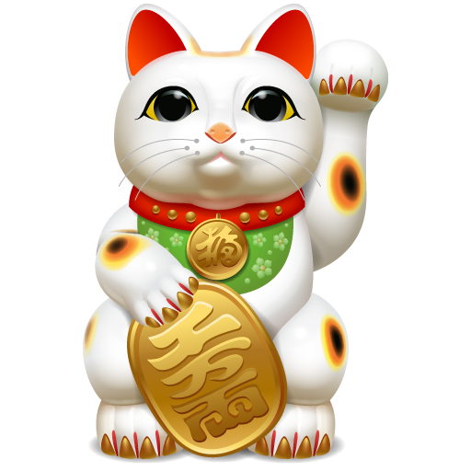
laki-laki

Slide 3
laki-laki
You could be excused for thinking that “laki-laki”, pronounced “lucky-lucky”, means “good luck” in Indonesian. Bad luck for you that it doesn’t!
Luckily for men, “laki-laki” means “male” in Indonesian.

Slide 4
laki-laki
If “laki-laki”, means “male” in Indonesian, then surely the word for “female” must be “unlucky-unlucky”!
No such luck! The word for female in Indonesian is “perempuan” , pronounced “pair-rem-poo-un”.

