Slide 2
lain

Slide 3
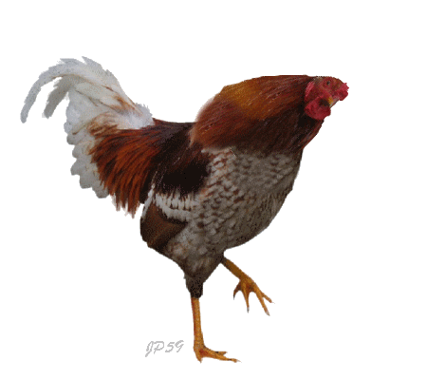
lain
You could be excused for thinking that “lain”, pronounced “lah-in” is the Indonesian word for “lion”. It sounds very similar!
However, the word “lain” means “other” in Indonesian.
I ain’t lyin’ when I say that “ayam” not a “lain” !

