Slide 2
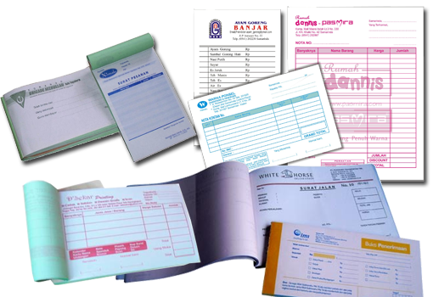
kwitansi

Slide 3
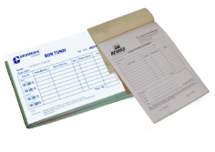
kwitansi
“kwitansi” is the Indonesian word for “receipt”. In Indonesia it is still common to receive hand-written receipts at small family-owned shops and businesses.
When shopping in Indonesia, don’t forget to “Minta kwitansi” as proof of your purchase.

