Slide 2
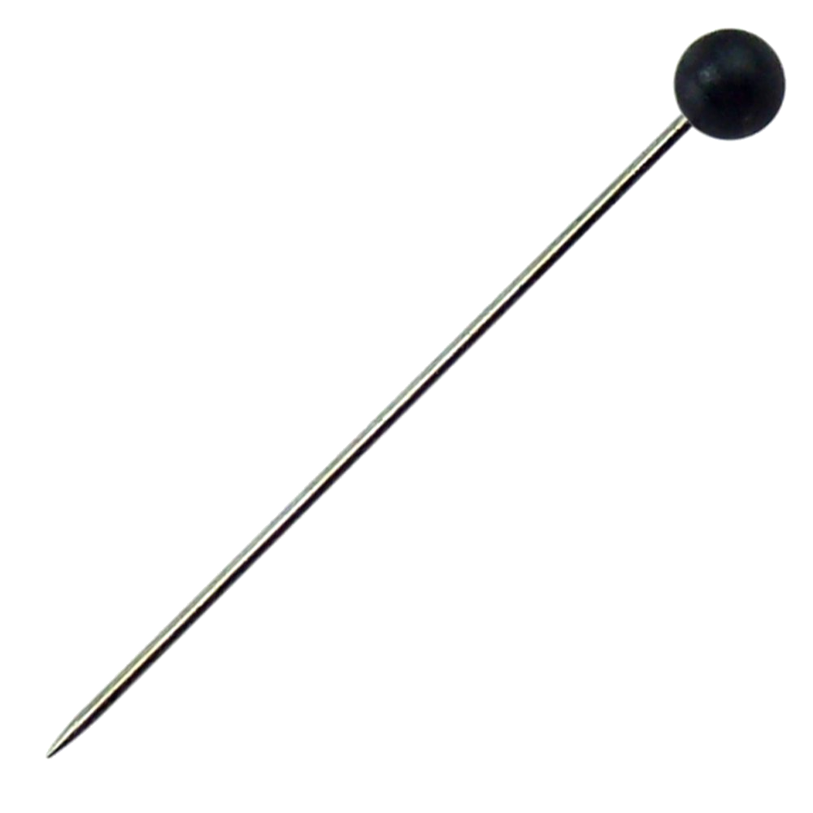
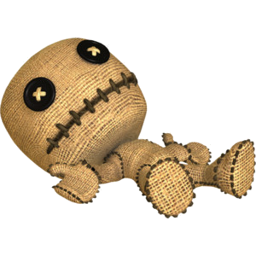
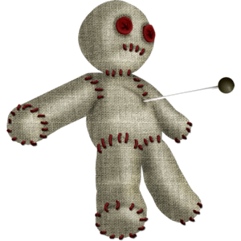
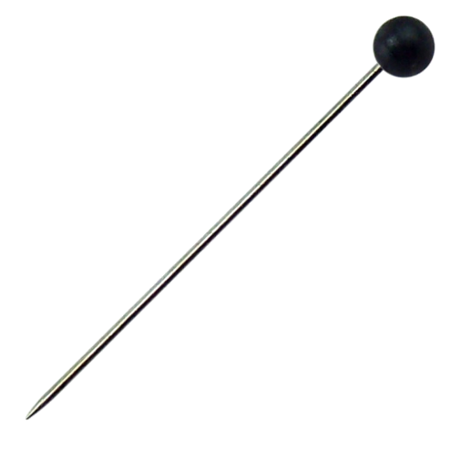
kursi

Slide 3
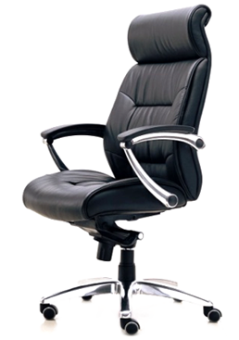
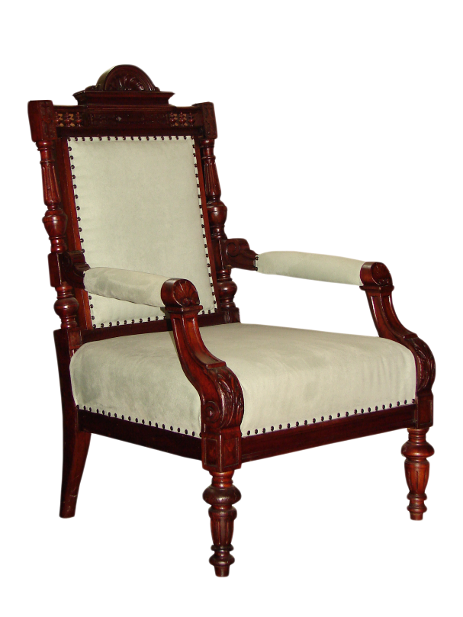
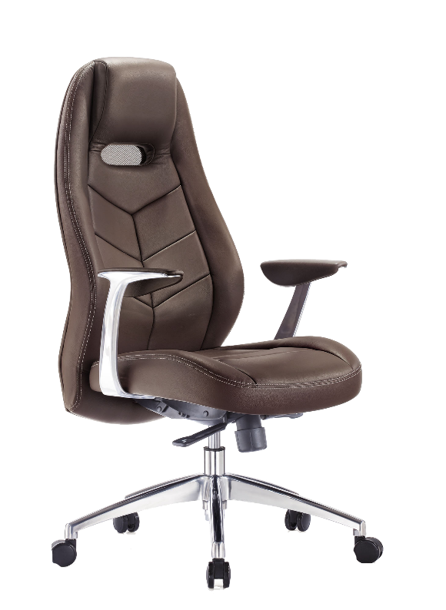
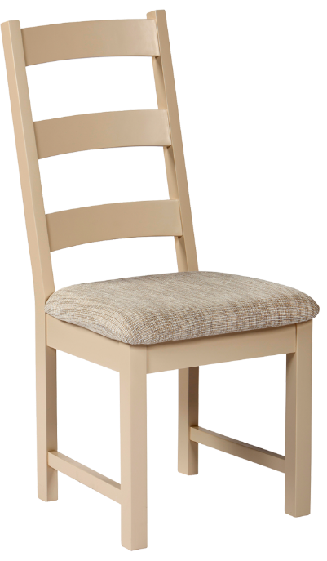
kursi
I know that you’re thinking that “kursi” must mean “curse”, right? Nothing could be further from the truth!
The noun “kursi”, pronounced “koor-sih”, actually means any kind of “chair” in Indonesian.

Slide 4
kursi
Most Westerners are cursed because they are unable to roll their “r”s in Indonesian. Because of this, they pronounce “kursi” as “cursey”. Are you “cursed” ???
If you can say “Harry”, you should be able to say “kursi”!

