Slide 2
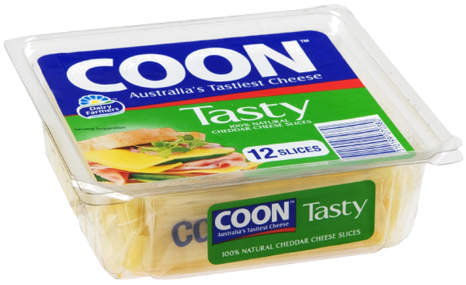
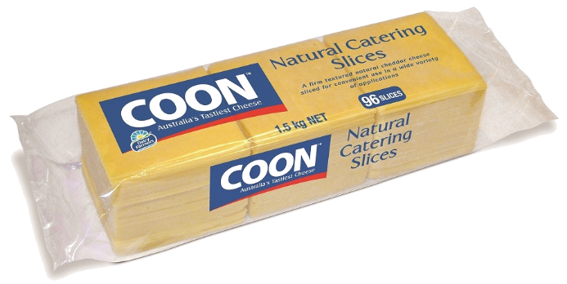
kunci

Slide 3
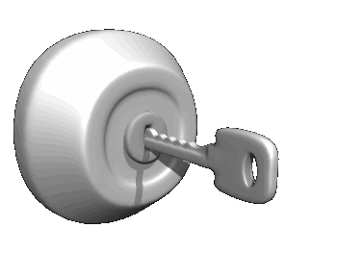
kunci
You’re thinking that if it looks like Coon Cheese and sounds like Coon Cheese then it must be Coon Cheese, right?
WRONG!!! The Indonesian word “kunci”, pronounced “kuhn-chi”, means “key”.
Unlock your true potential!
Make the study of Indonesian your key to future success!

Slide 4
kunci
With Indonesia predicted to become the 6th largest economy in the world by the year 2030, your success in this subject will allow you to finish in front of the crowd and on top of the pack.

