Slide 2
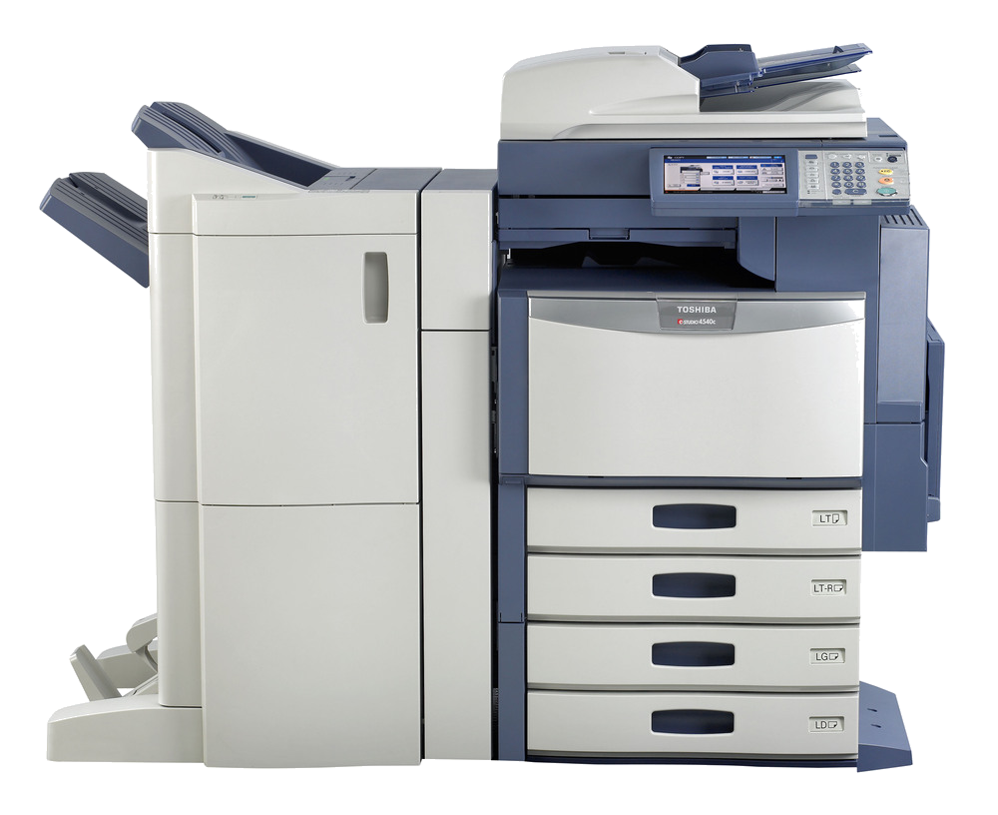
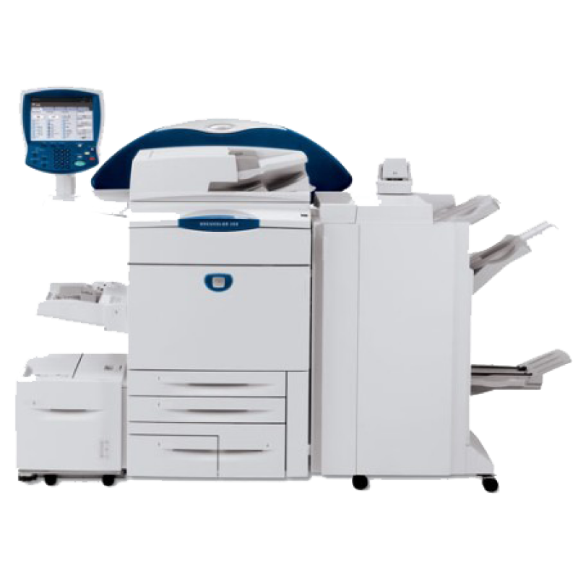
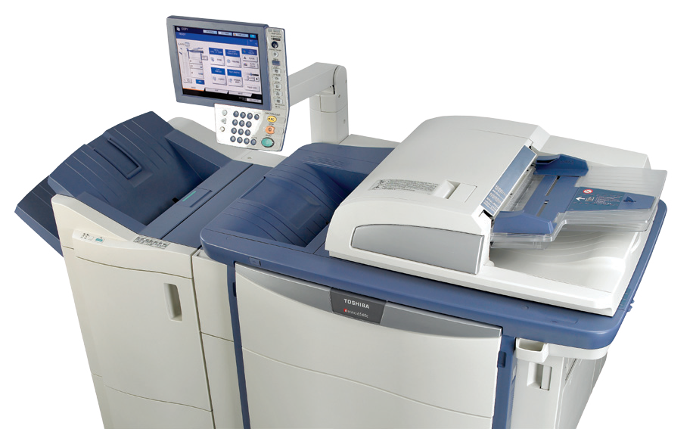
kopi

Slide 3
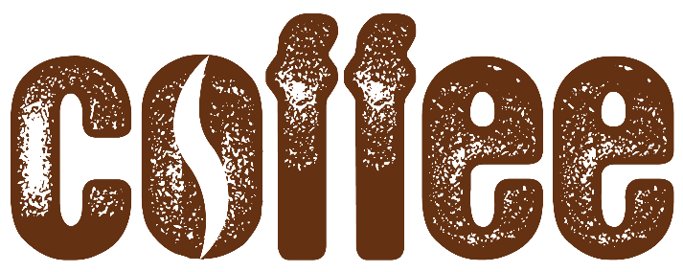
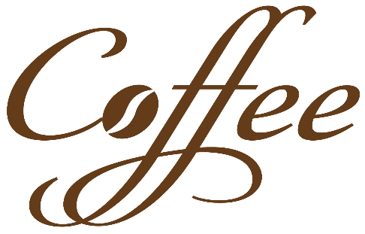
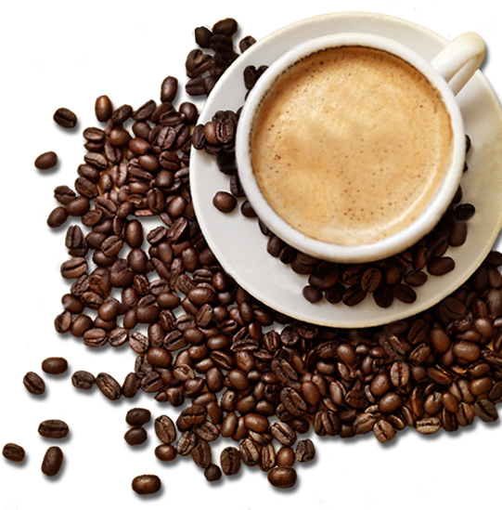
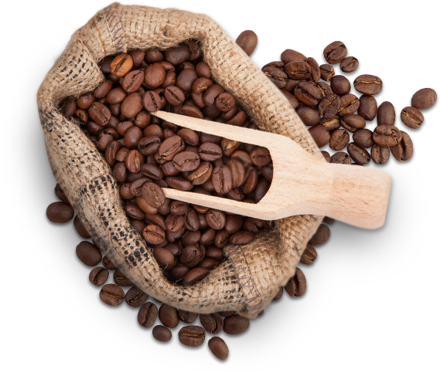
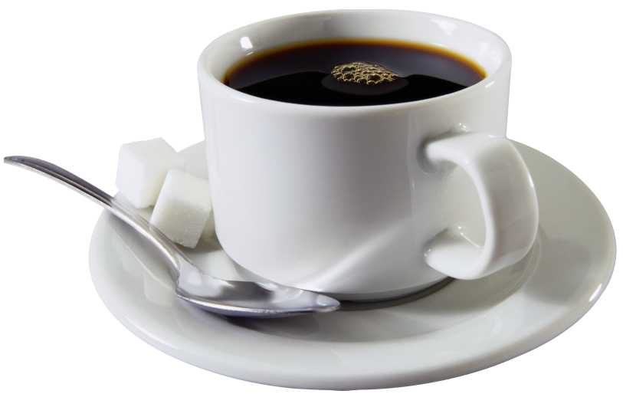
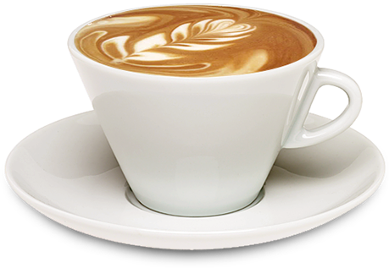
kopi
By now I’m certain that you think that “kopi” is the Indonesian word for “photocopy”, right? Wrong! The Indonesian for “photocopy” is “fotokopi”!
So what is “kopi”? The noun “kopi” is the Indonesian word for “coffee”.

Slide 4
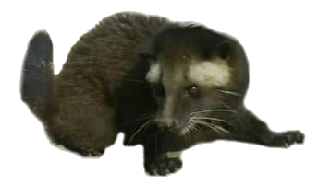
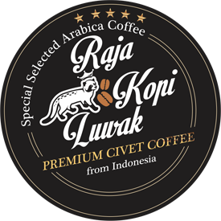
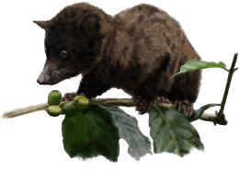
kopi luwak
“Kopi luwak” from Indonesia is the most expensive coffee in the world, costing between $50 & $120 per cup in a regular coffee shop!
“Kopi luwak”, or civet coffee, refers to the coffee that includes part-digested coffee cherries eaten and defecated by the Asian palm civet, a cat-like species native to Indonesia.

Slide 5
kopi
Let’s finish with a riddle! What do you call a photo of coffee in Indonesian? You call it a “foto kopi”!

