Slide 2
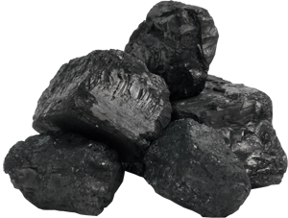
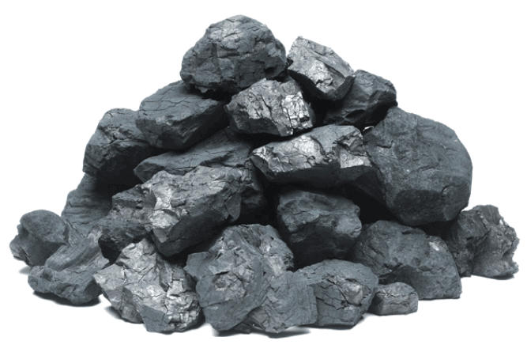
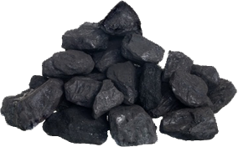
kol

Slide 3
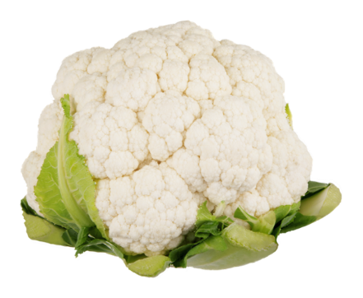
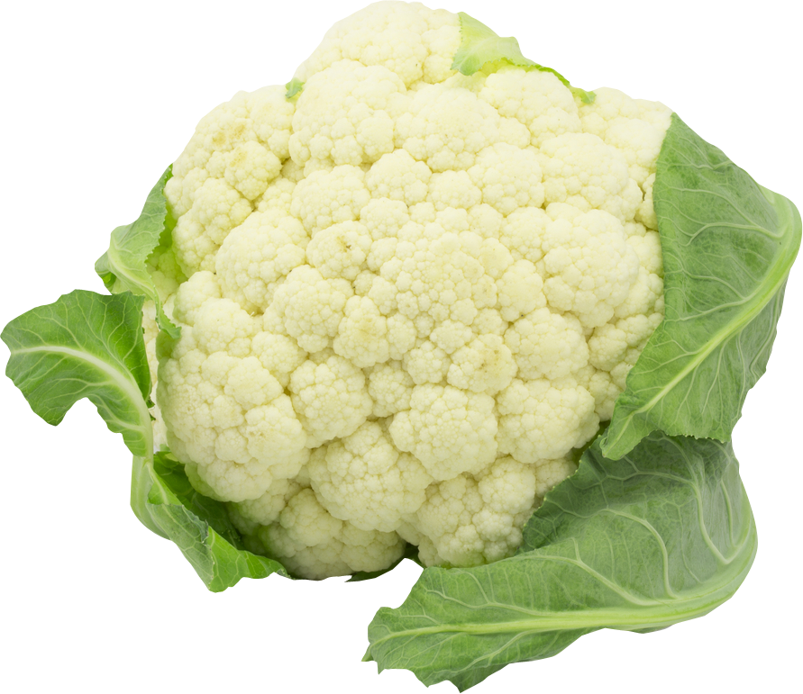
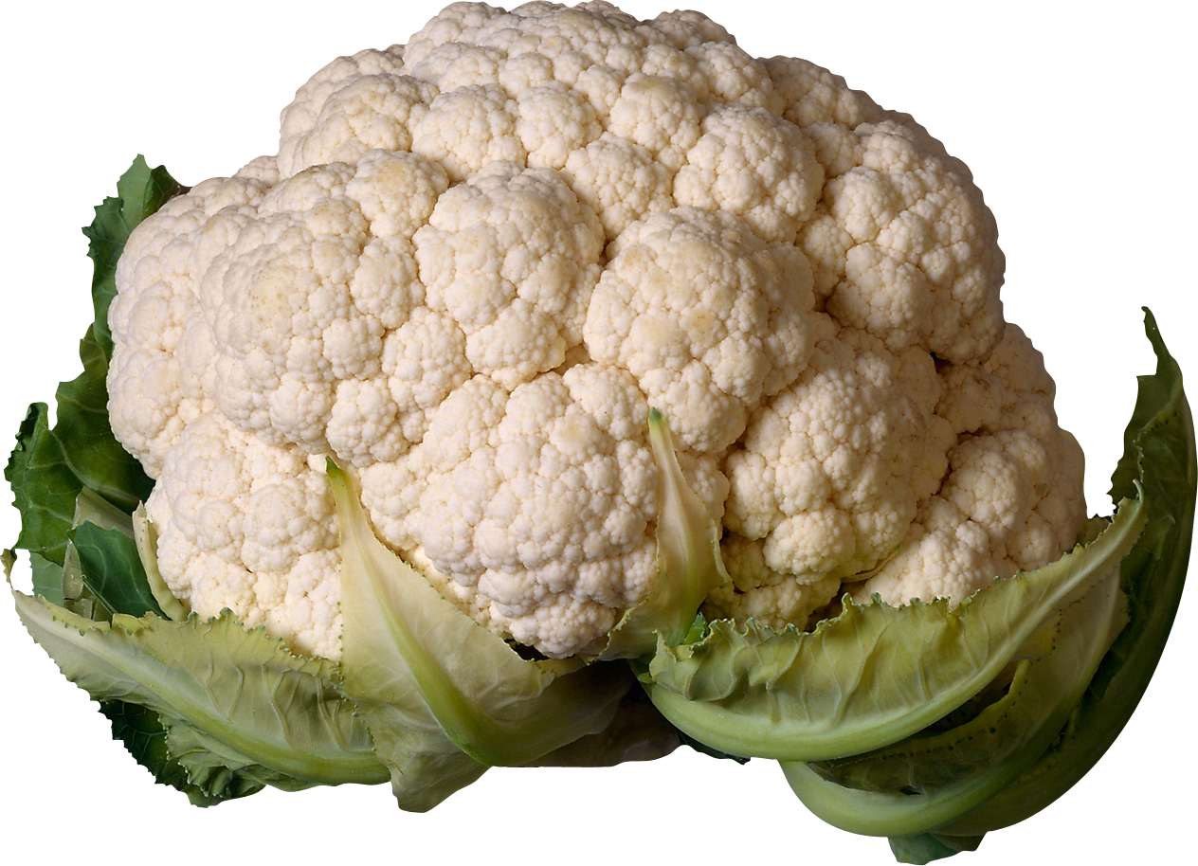
kol
You are probably thinking that “kol” , pronounced “coal” , is the Indonesian word for “coal”, right? Sorry, but when the heat is on, you’ve come up cold yet again.
The noun “kol” is actually “cauliflower” in Indonesian.

Slide 4
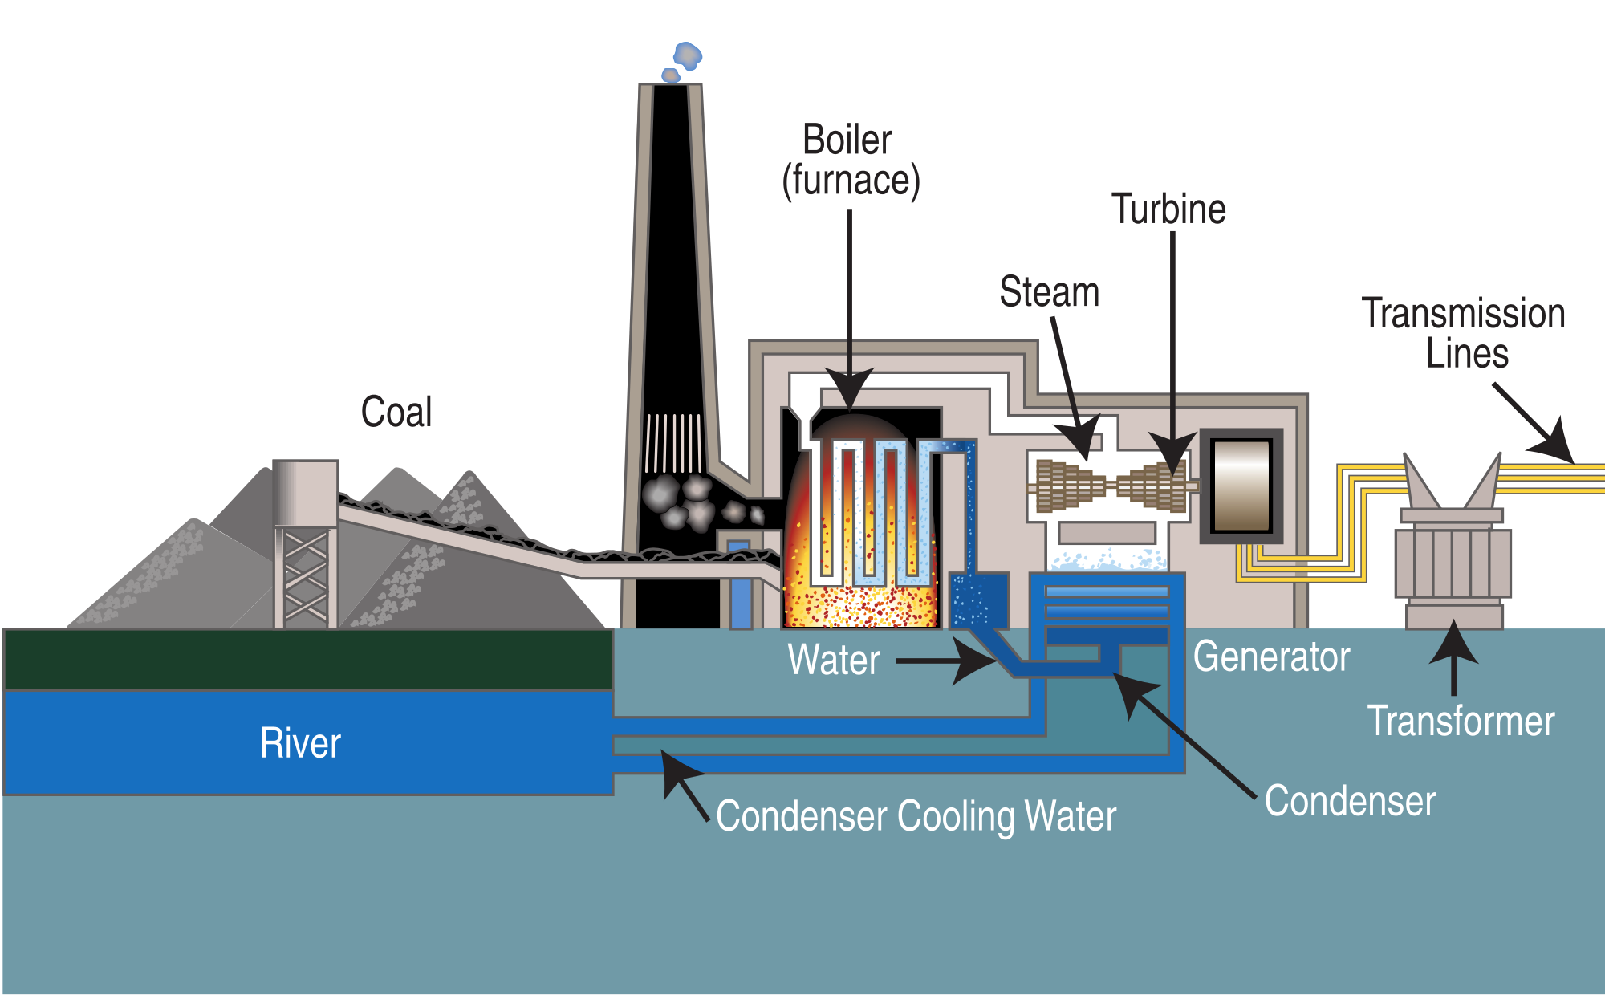
kol
Despite its reputation for environmental devastation on a global scale, I can assure you that are no “kol” fired power stations in Indonesia!

