Slide 2
khianat

Slide 3
khianat
I suppose you think that “khianat”, pronounced “he-a-nut”, means “he’s a nut” in Indonesian, right?
You’d “soitenly” be a stooge if you believed that!

Slide 4
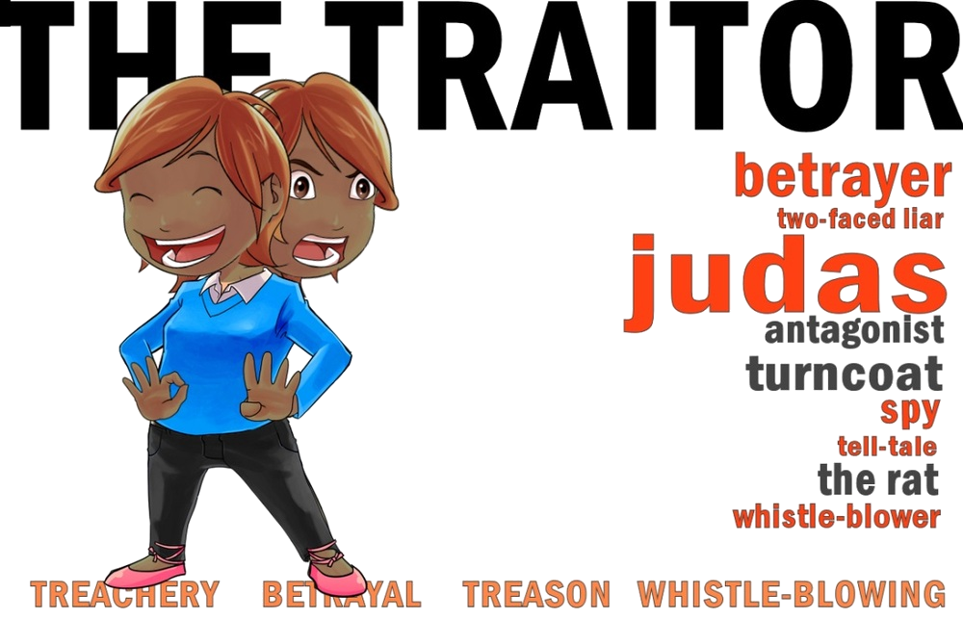
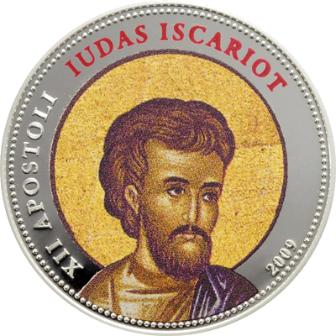
khianat
The adjective “khianat” means “traitorous” or “treacherous” and the noun “pengkhianat” means “a traitor” in Indonesian.

Slide 5
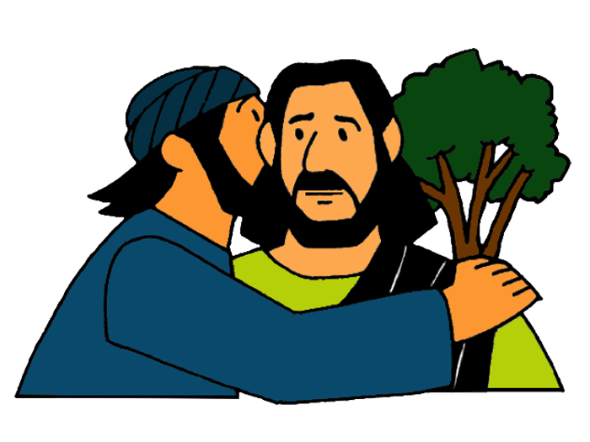
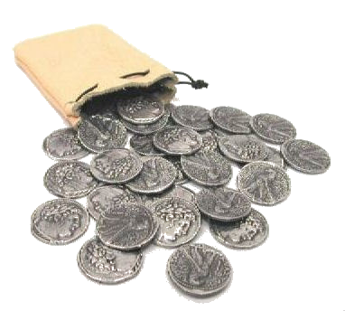
khianat
The most famous “pengkhianat” or “traitor” in all of history was Judas Iscariot who betrayed Jesus for 30 pieces of silver, which, today, is worth around $US600.
Before betraying Jesus, he whispered, “I love you like family”, to him. No wonder the word
“judas” means “cruel” or
“vicious” in Indonesian!!!

