Slide 2
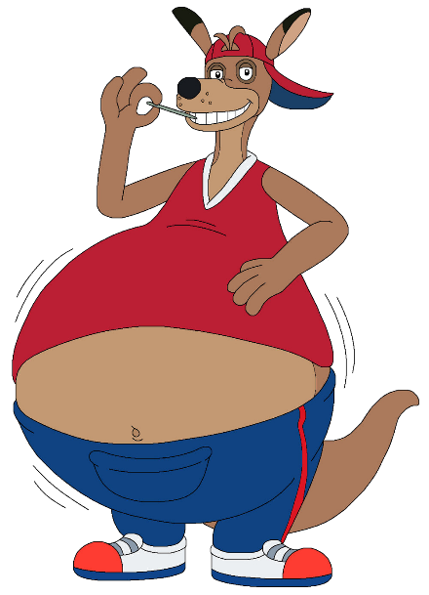
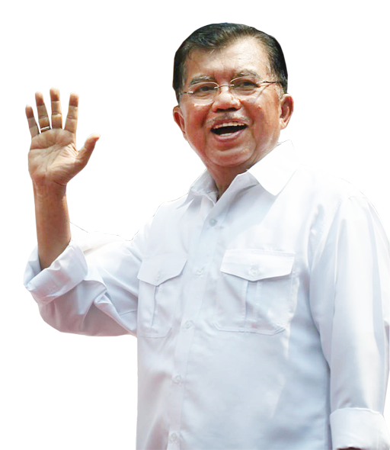
kenyang
Hello, I’m Ken Young from
Australia

Slide 3
kenyang
I guess that means more for me, Mister !

Slide 4
kenyang
The Indonesian verb “kenyang” , which is pronounced exactly the same as the name “Ken Young”, means “to be full or satisfied” .
Are you “kenyang” ??? If not, go to the next slide !

Slide 5
kenyang

