Slide 2
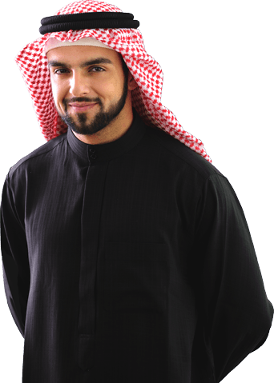
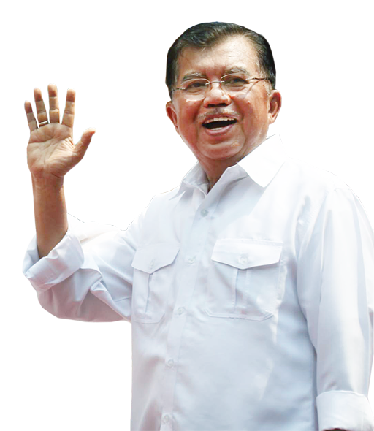
kentut
Hello, I’m Ken
Toot from
Kuwait.

Slide 3
kentut
Sorry, I didn’t
quite get your name.

Slide 4
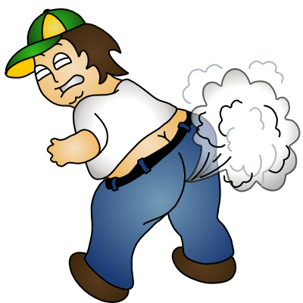
kentut
That’s okay. My name is Ken Toot !

Slide 5
kentut
My hearing is
bad! Can you please repeat your name one more time.

Slide 6
kentut
Yes, certainly. I’m Ken Toot !

Slide 7
kentut
Pleased to meet you, Mr Kentut. Your name is very popular in Indonesia!

Slide 8
kentut

Slide 9
kentut
The Indonesian verb “kentut” pronounced “Ken Toot” (“oo” as in “foot”), means “to fart”.
Please heed the request of the Vice President and don’t fart in your Indonesian class!
Janganlah kentut di ruangan kelas Bahasa Indonesia!

