Slide 2
kentang
Ken

Slide 3
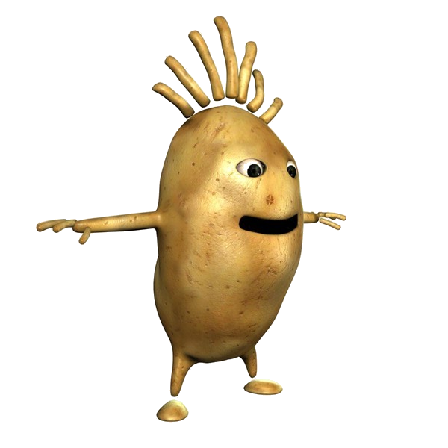
kentang
My name is Ken Tongue and here is my family. We certainly have a lot of appeel.

Slide 4
kentang
As we grow and come of age, our appeel increases as you can see from these recent family photos.

Slide 5
kentang
Enjoy eating us but be careful not to bite your lips or tongue !

Slide 6
kentang
If you still haven’t figured it out, “kentang” is the Indonesian word for “potato”. It is not at all difficult to pronounce so you won’t have to twist your tongue, Ken!

