Slide 2
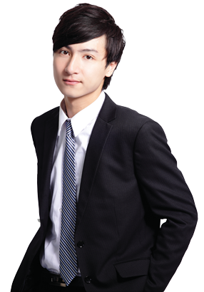
kencing
Hello, I’m Ken Ching from
Hong Kong.

Slide 3
kencing
It’s over there, Mister !

Slide 4
kencing
The Indonesian verb “kencing” , which is pronounced exactly the same as the Chinese name “Ken Ching”, means “to urinate” .
If you want to “kencing” go to the toilet during your breaks, not in my class time !!!

Slide 5
kencing
And don’t make a mess !!!

