Slide 2
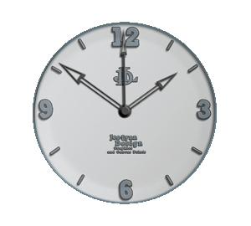
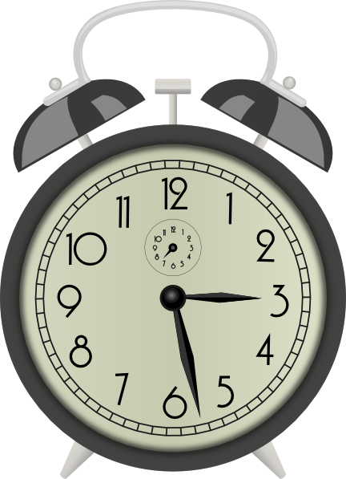
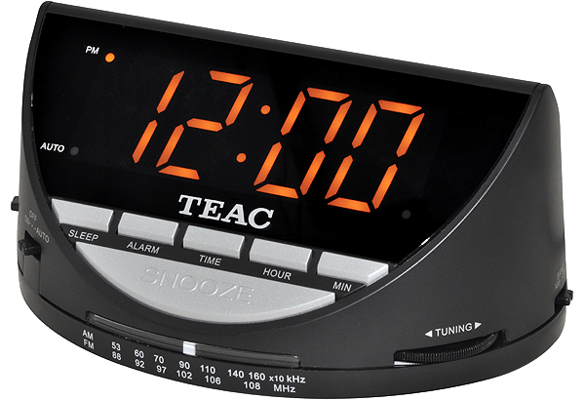
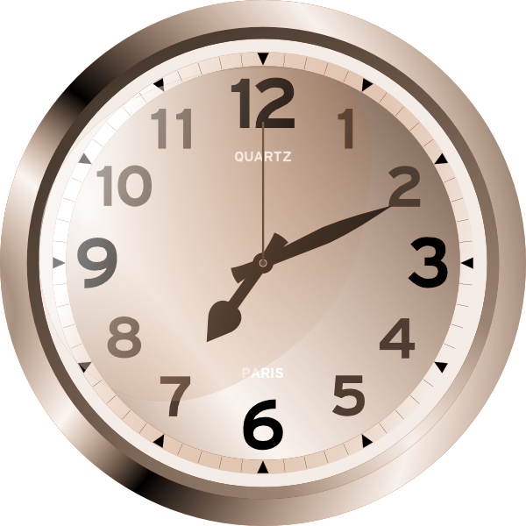
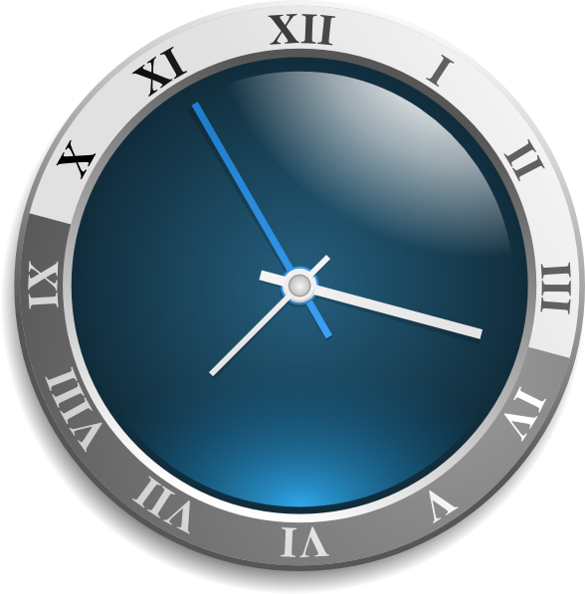
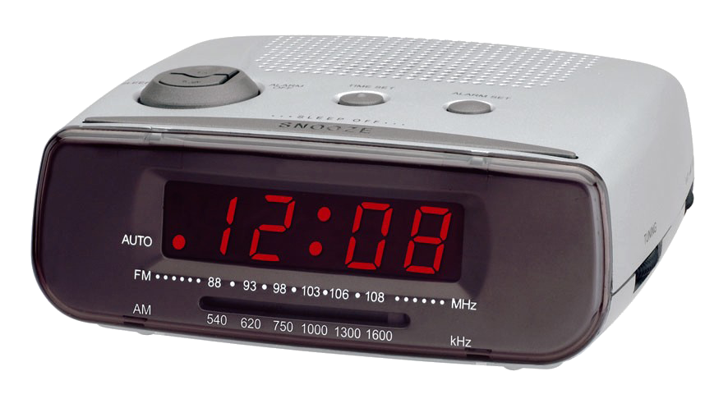
kelok

Slide 3
kelok
I’m certain that you think “kelok” , pronounced “ker-lock” means “clock” in Indonesian, right?
Sorry to disappoint you, but you are actually wrong this “time”.
The noun “kelok” , amongst other things, means “a turn”, “ a bend” or a “a curve” in the road in Indonesian.

Slide 4
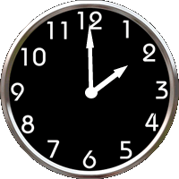
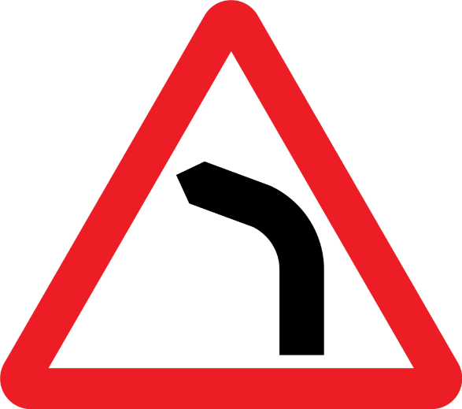
kelok
Life takes all sorts of twists and turns but with “time” it’s all one way traffic … or is it ???

