Slide 2
karpet

Slide 3
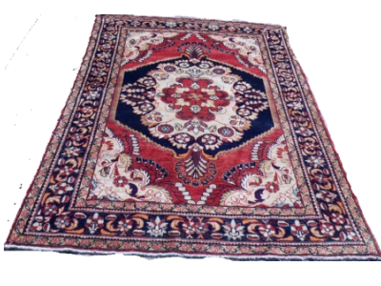
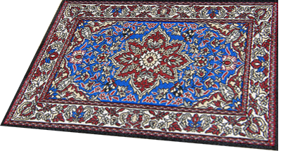
karpet
You are probably thinking that “karpet” is a pet that likes going on long drives in a car, right?
Sorry to disappoint you, but “karpet” , pronounced “car-pet” is the Indonesian word for “carpet”!

Slide 4
karpet
Let’s roll out the red “karpet” for the Word of the Day.

Slide 5
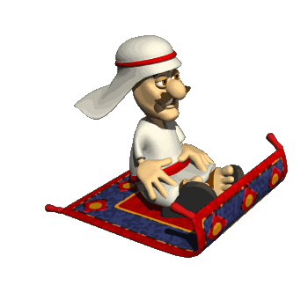
karpet
Each day it takes you on a magical “karpet” ride as you explore new and interesting Indonesian vocabulary.

