Slide 2
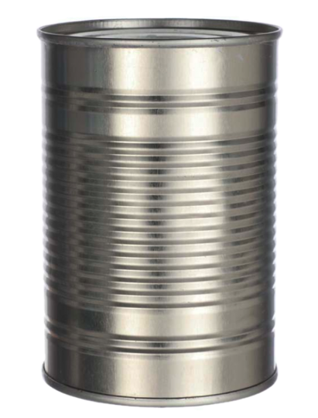
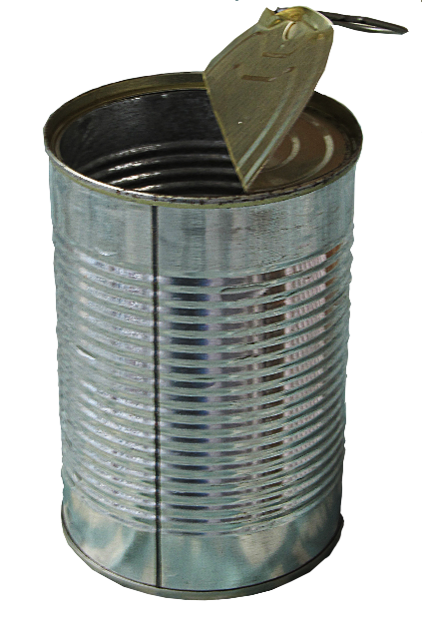
kantin

Slide 3
kantin
As you already know that an adjective follows a noun in Indonesian, I assume that you think that “kantin”, pronounced “kun-tin”, means “tin can” in Indonesian, right?
Well, you can “can” that idea because the noun “kantin” means “canteen” in Indonesian.

Slide 4
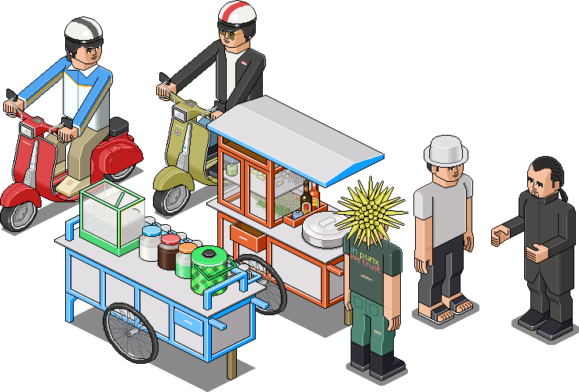
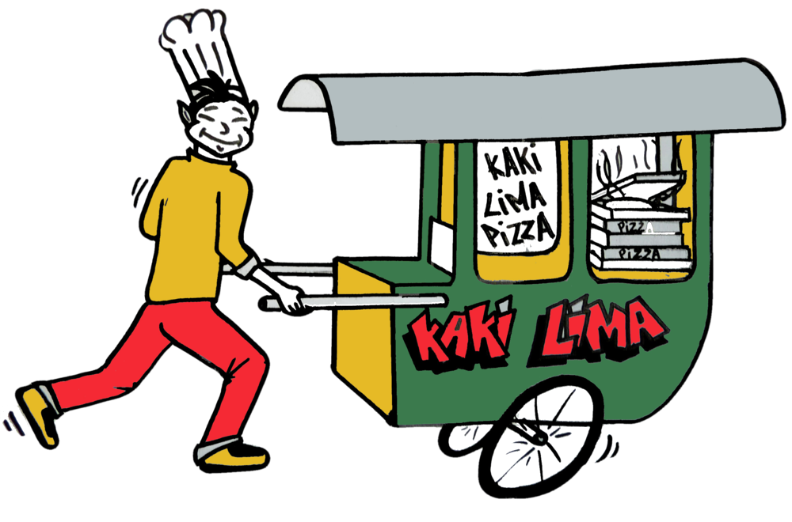
kantin
You have already learnt that most Indonesian schools do not have a proper “kantin”, but only a temporary food stall or “warung”, because most students go home, or elsewhere, for lunch when school ends at 1:00 p.m.

Slide 5
kantin
Being people of ingenuity and resourcefulness, Indonesians have used their many discarded “kantin” to create the world’s first mobile phone, the Indorola KalengTel (the Indorola CanPhone) !

