Slide 2
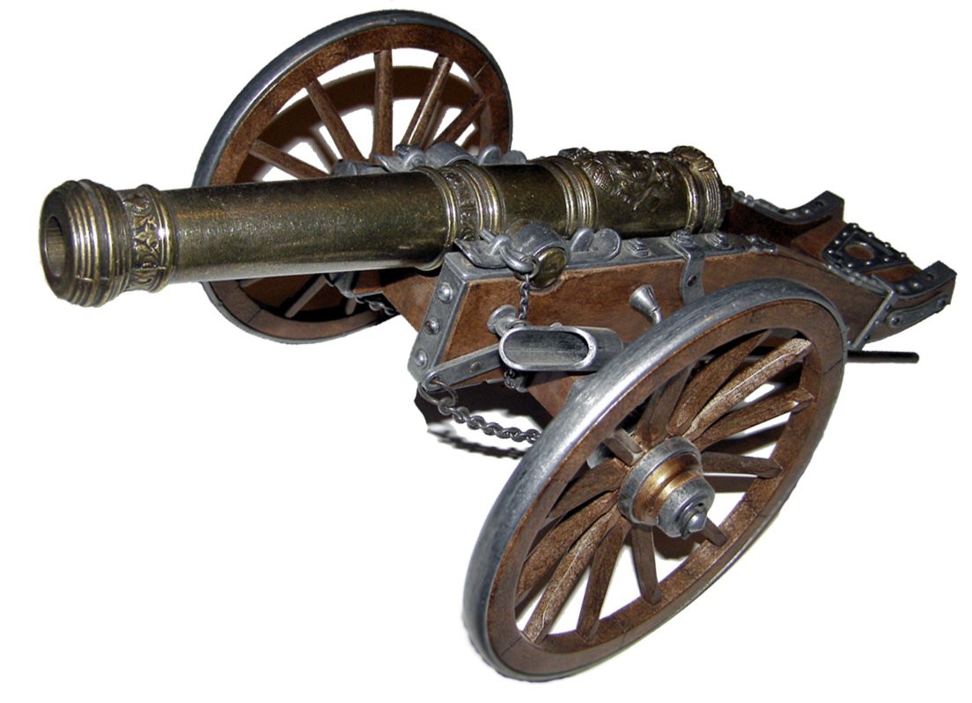
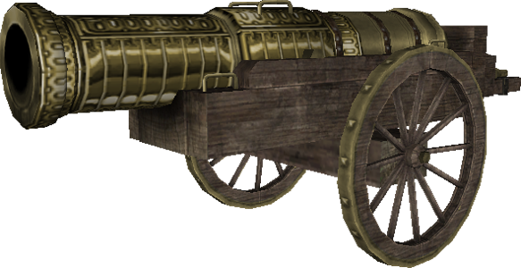
kanan

Slide 3
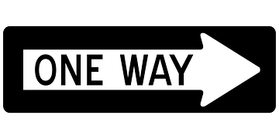
kanan
You’re probably thinking that “kanan”, pronounced “car-nun”, is the Indonesian cognate for the word “cannon”, right?
Unfortunately, you have made a false assumption!
The word “kanan” actually means the direction “right”.

Slide 4
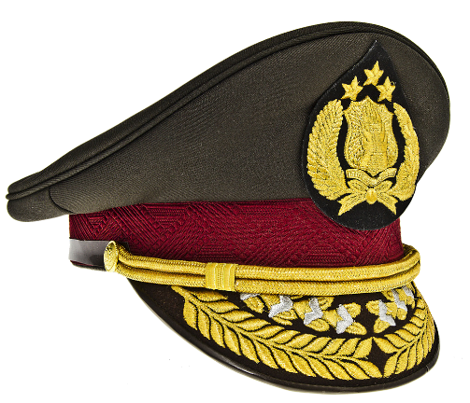
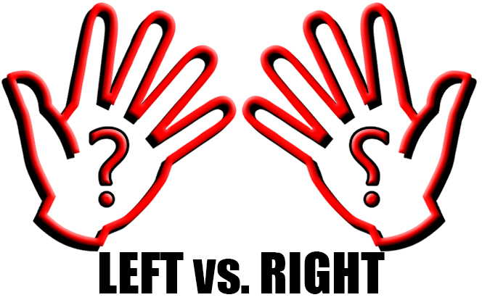
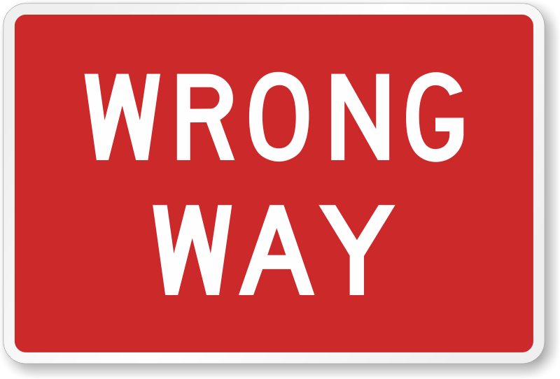
kanan
If you don’t learn the difference between “kiri” and “kanan” when driving in Indonesia, you may find yourself in the firing line of the law!

