Slide 2
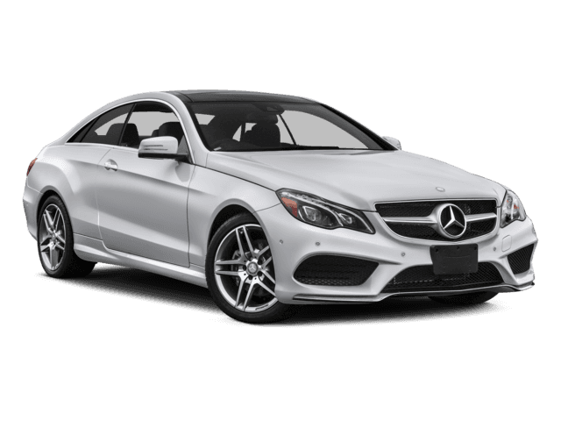
kami

Slide 3
kami
You probably think that “kami”, pronounced “car-me”,
means “my car” in Indonesian, right?
As usual “kami”, your Indonesian teachers, need to correct you because “kami” means “we”, “our” or “us” but excludes the person you are speaking to, or the listener.

Slide 4
kami
Unfortunately, “kami” is facing extinction in Indonesia because many Indonesians, themselves, are incorrectly using “kita” instead of “kami”.
“Kita” also means “we”, “our” or “us” but it includes the person you are speaking to, or your audience.
Let’s preserve “kami” as a word by always using it correctly and surprising Indonesians !

Slide 5
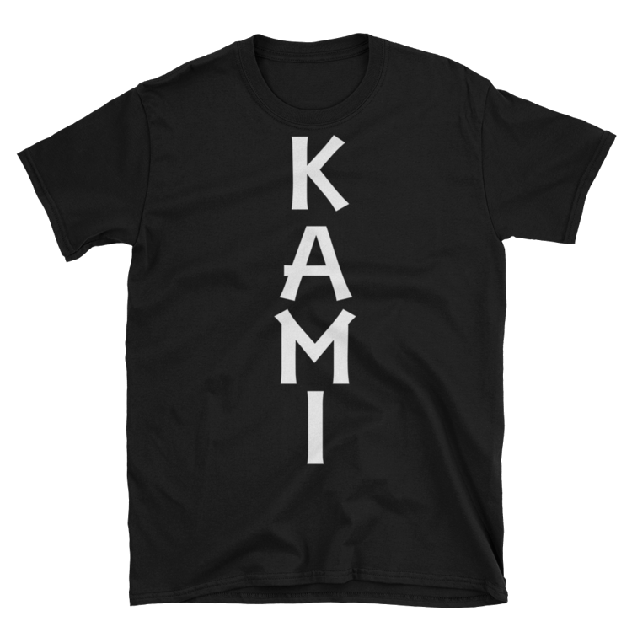
kami
If “kita” all work hard at it, “kita” might just be able to save “kami” from extinction.

