Slide 2
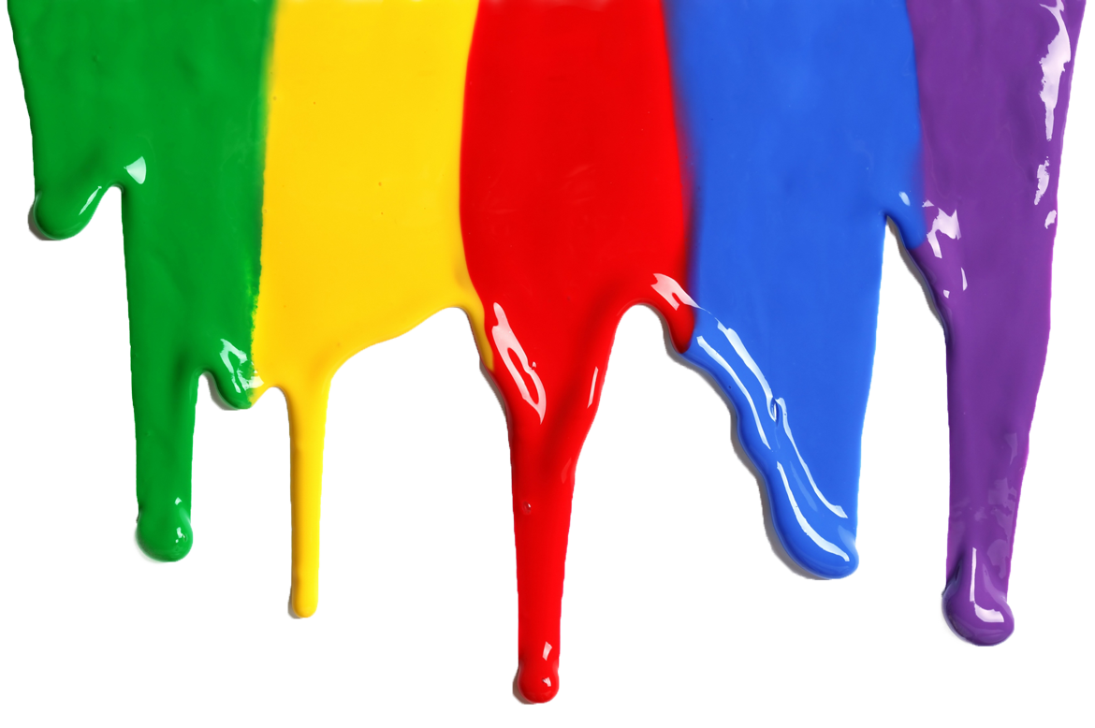
kalah

Slide 3
kalah
I’ll bet you’re thinking “kalah”, pronounced “colour”, is the Indonesian word for “colour”, right?
Sorry, but you have suffered yet another defeat! The verb “kalah” means “to lose” or “be defeated” in Indonesian.

Slide 4
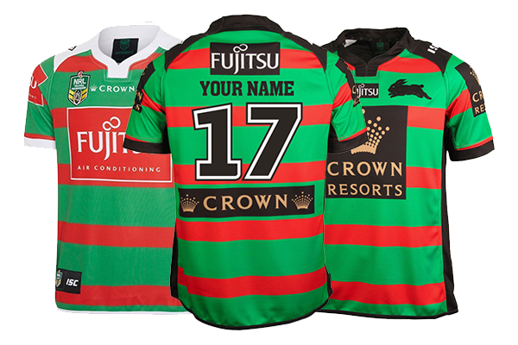
kalah
One pair of colours that will never “kalah” are the red and green of the South Sydney Rabbitohs. Since their inception in 1908 they have inflicted many a “kalah” on all the other teams in the competition! One could say they have remained true to their colours!

