Slide 2
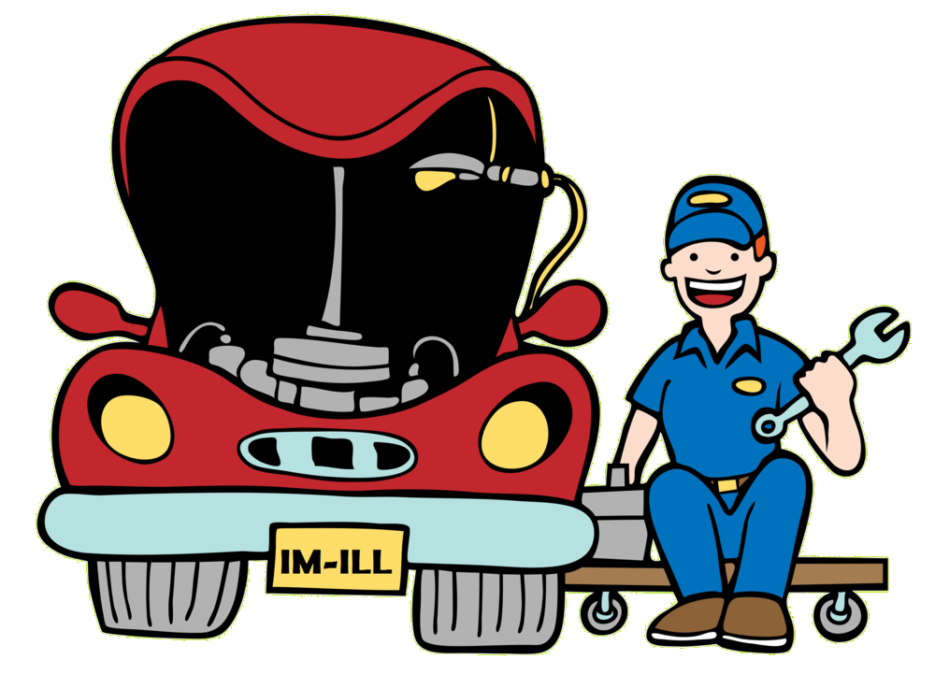
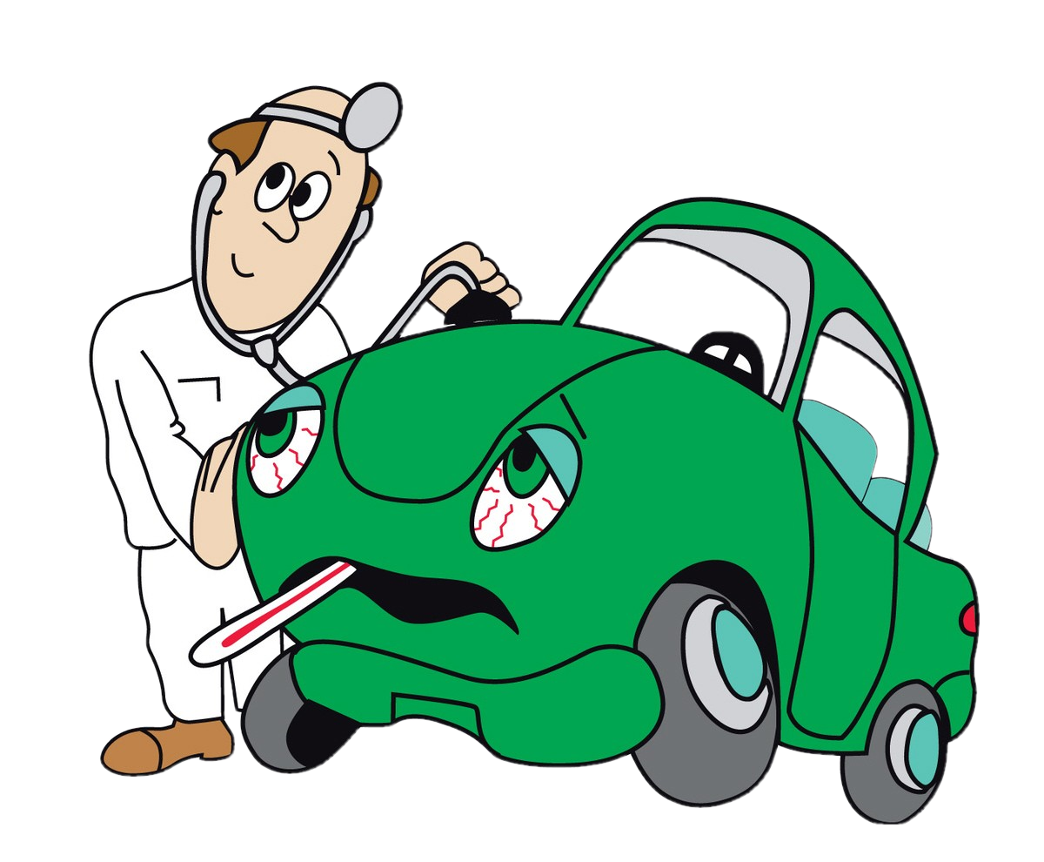
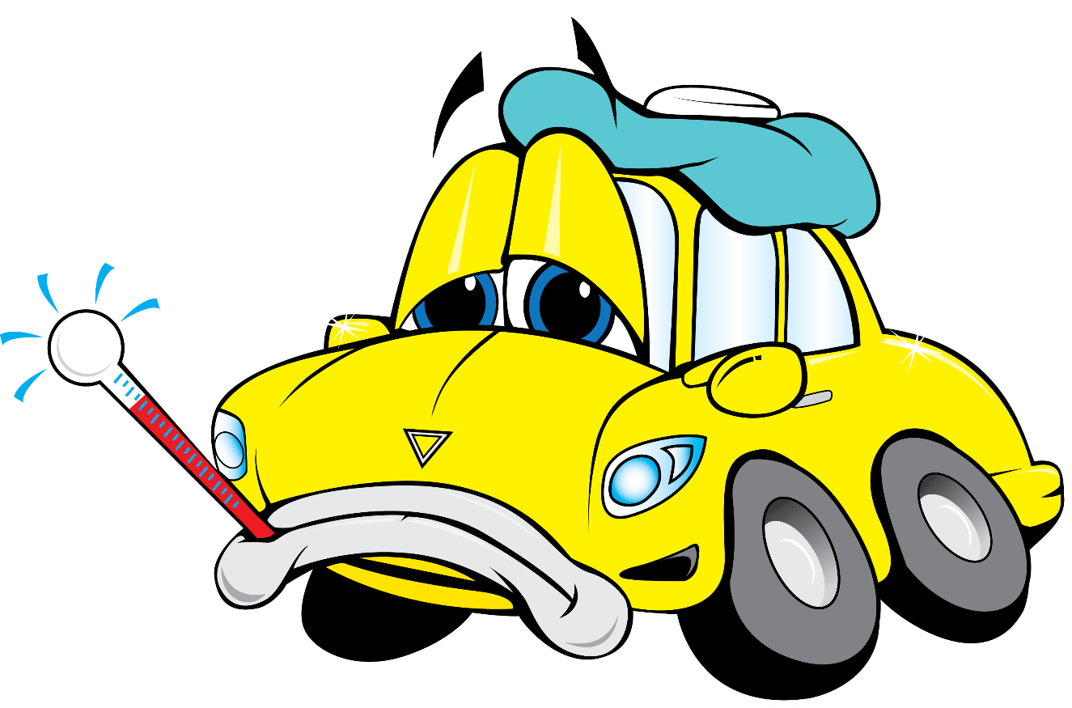
kail

Slide 3
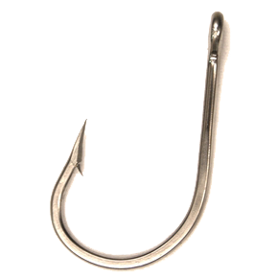
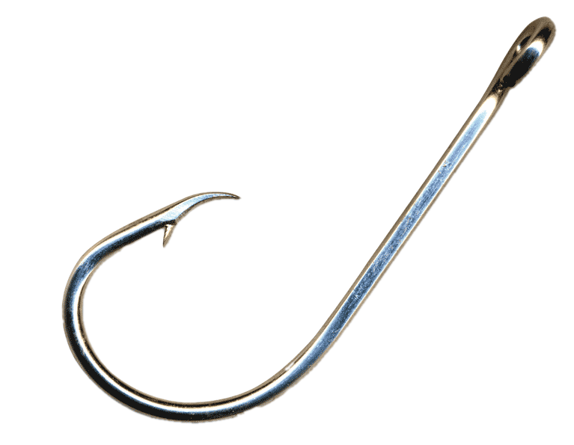
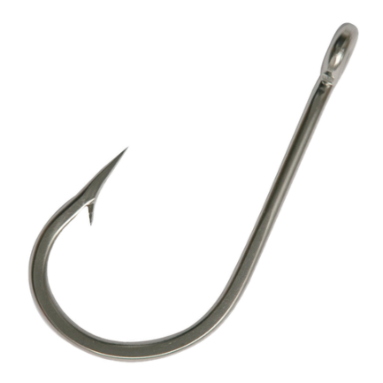
kail
You are probably thinking that “kail”, pronounced “car-ill”, means “sick car” in Indonesian, right?
Well, you’ve taken the bait and I’ve “hooked” you yet again!
The noun “kail” means “hook” in Indonesian.

Slide 4
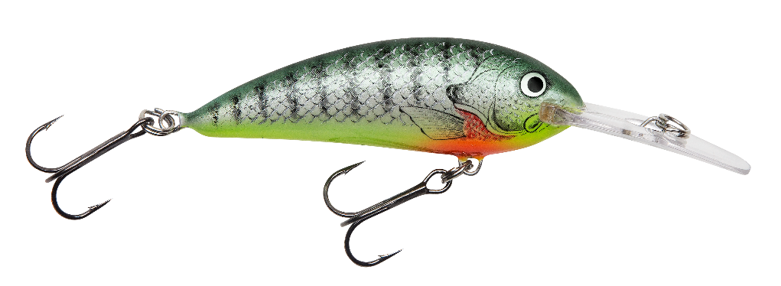
kail
Hopefully, over the coming weeks and months, I can lure you with more WORDs Of The DAY now that you are “hooked”.

