Slide 2
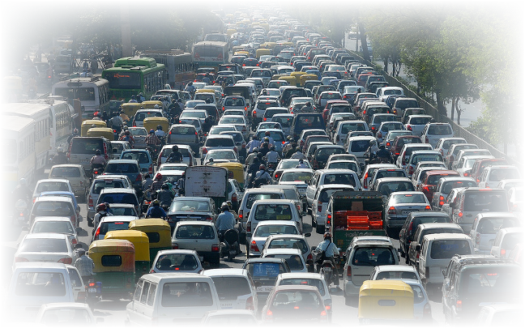
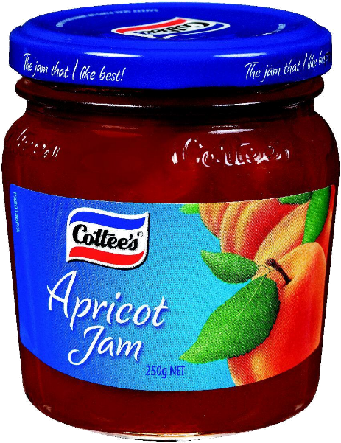
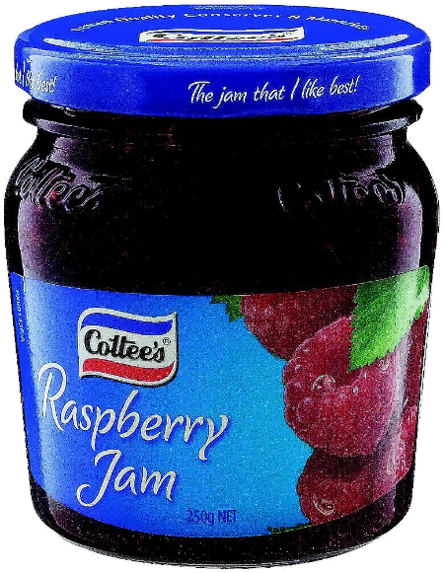
jam

Slide 3
jam
It sure looks like everyone is in a bit of a “jam” !
In Indonesian, however, “jam” (which is pronounced “jum”), means something totally different.
“Jam” means “hour” , “o’clock” or “timepiece” (watches and clocks).
Unlike Australians, Indonesians aren’t usually punctual and tend to follow a system called “jam karet” or “rubber (elastic) time”!

Slide 4
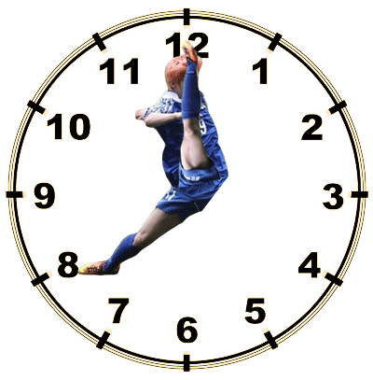
jam
Don’t you try to introduce “jam karet” to Browns Plains State High School! We have ways of dealing with lateness! Be on time or you’ll find yourself in a “jam”!

