Slide 1
In The Bag Pronunciation Guide
Say It Like It Is

Slide 2
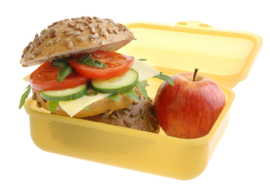
kotak makanan
ko-tak ma-ka-nan
lunchbox

Slide 3
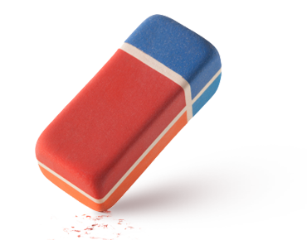
penhapus
peng-ha-pus
eraser

Slide 4
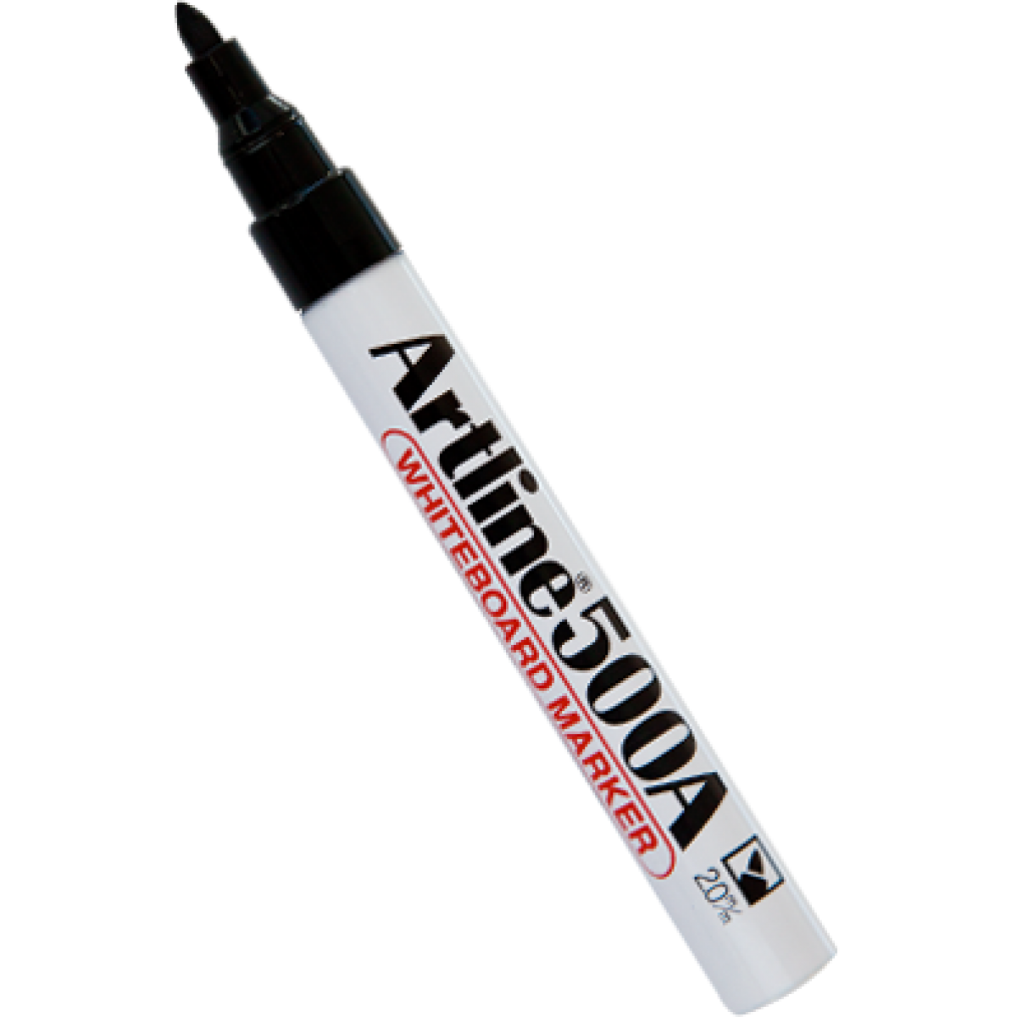
spidol
spi-dol
whiteboard marker

Slide 5
pena
pe-na
pen

Slide 6
pensil
pen-sil
pencil

Slide 7
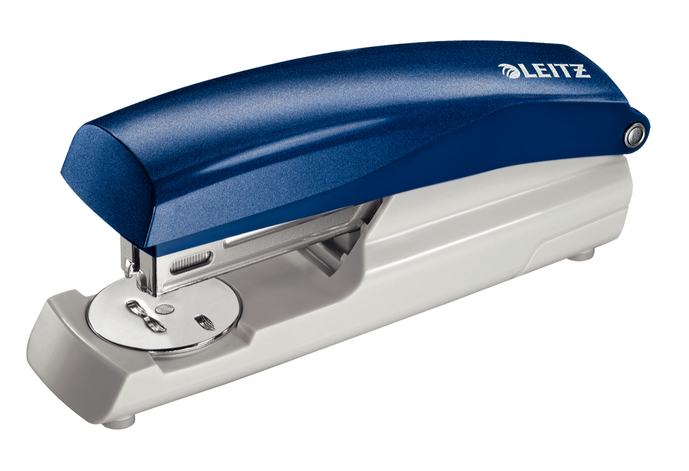
jepretan
je-pre-tan
stapler

Slide 8
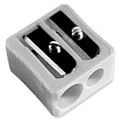
peruncing pensil
pe-run-cing pen-sil
pencil sharpener

Slide 9
penggaris
peng-ga-ris
ruler

Slide 10
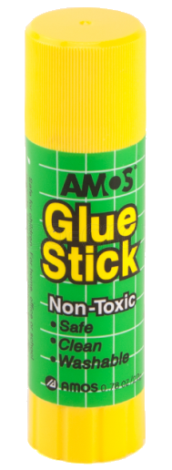
lem
lem
glue

Slide 11
map
map
folder

Slide 12
buku harian
buku ha-ri-an
diary

Slide 13
buku catatan
buku ca-ta-tan
notebook

Slide 14
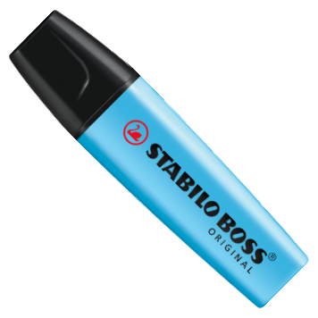
Stabilo
Sta-bi-lo
highlighter pen

Slide 15
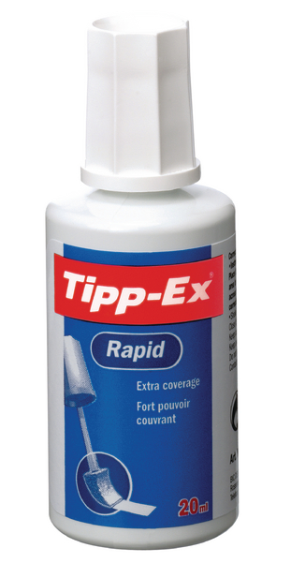
Tipex
Ti-pex
correction fluid

Slide 16
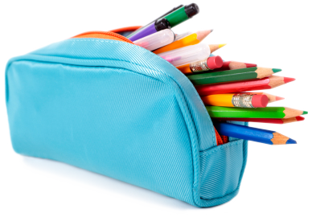
kotak pensil
ko-tak pen-sil
pencil case

Slide 17
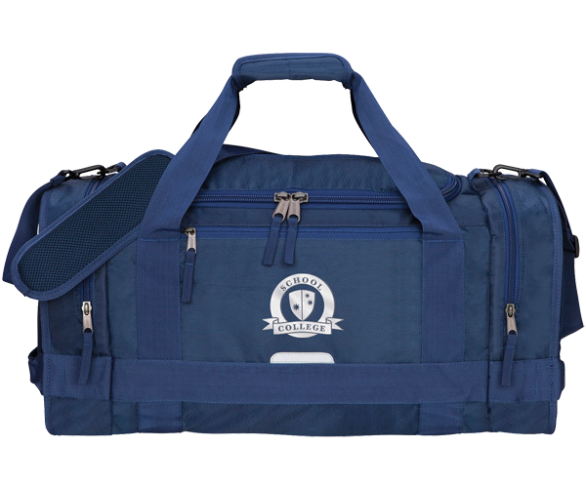
tas
tas
bag

Slide 18
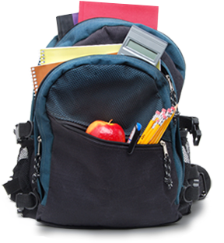
ransel
ran-sel
backpack

Slide 19
gunting
gun-ting
scissors

Slide 20
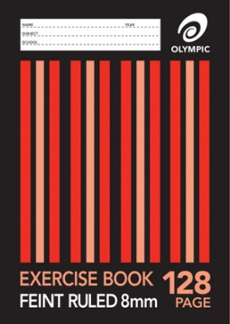
buku latihan
bu-ku la-ti-han
exercise book

Slide 21
buku pelajaran
bu-ku pe-la-ja-ran
exercise book

Slide 22
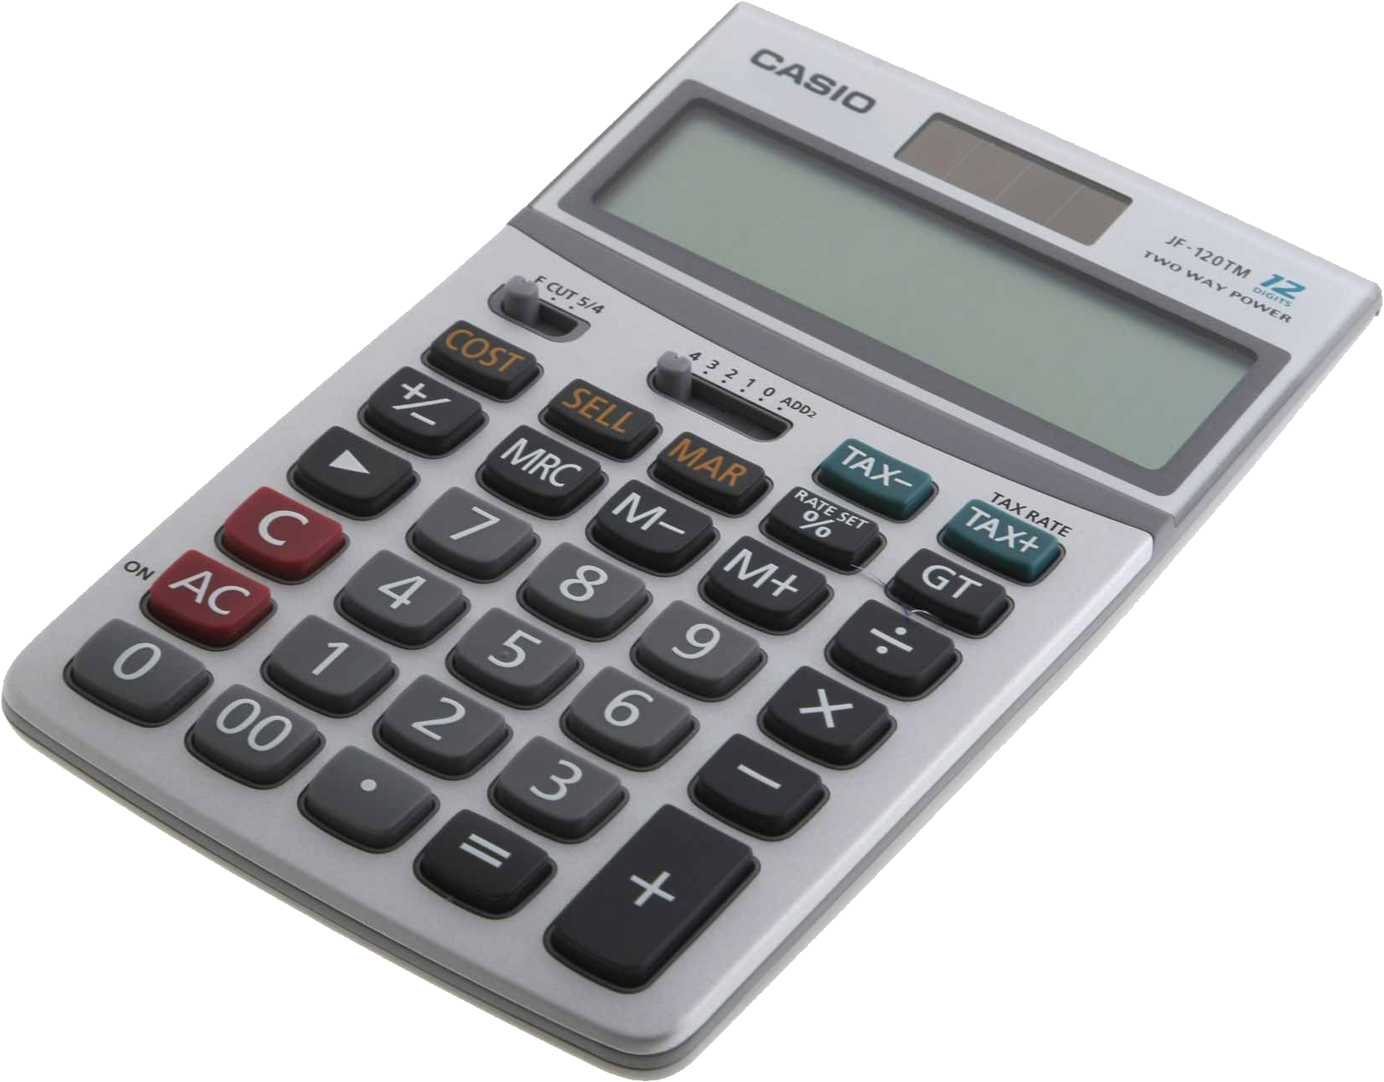
kalkulator
kal-ku-la-tor
calculator

