Slide 1
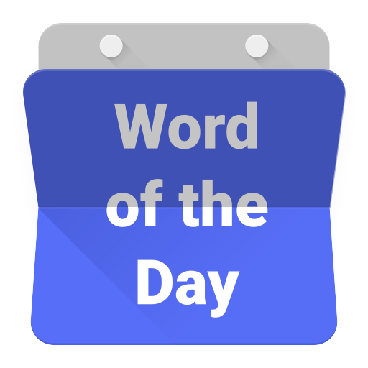

Slide 2
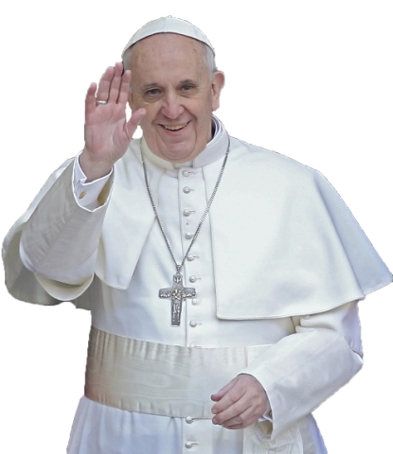
ikan paus

Slide 3
ikan paus
I know what you’re thinking … what on earth has a fish got to do with the Pope???
Translated word-for- word, “ikan paus”, pronounced “ih-kun pah-oos”, means “Pope fish”.

Slide 4
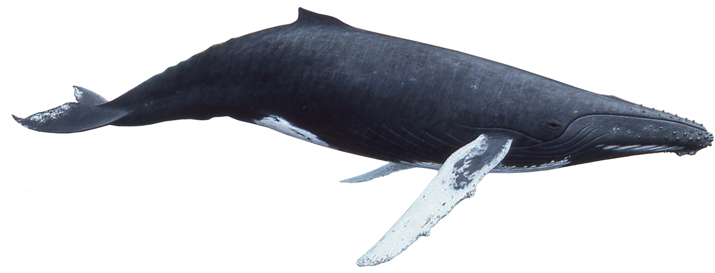
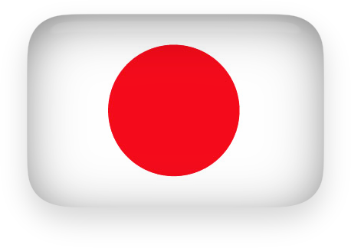
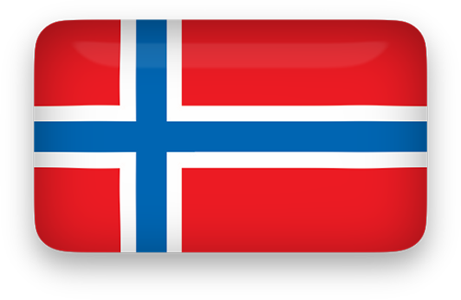
ikan paus
Just like the Pope is the leader of the Catholic Church, the “Pope fish” or “whale” is the king of the ocean.
Because of this, Japan and Norway should “paus” and rethink their attitude towards this most majestic of all “ikan”.

Slide 5
ikan paus

Slide 6
ikan paus
Say “No Way” to Norway!

