Slide 2
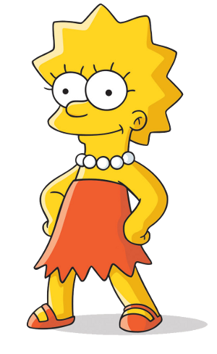
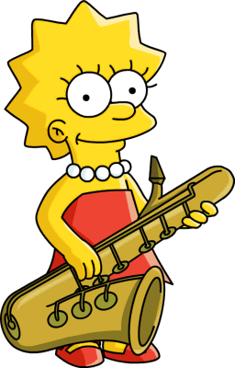
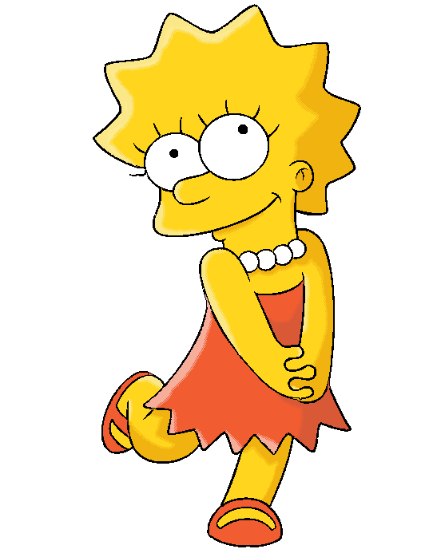
her

Slide 3
her
You are probably thinking that the word “her”, pronounced “hair”, means “her” in Indonesian, right?
Don’t write that in an exam because you would be incorrect!
The noun “her” refers to a repeat exam that Indonesian students are allowed to sit if they fail the original exam.

Slide 4
her
With more than 50 million students studying in Indonesian schools, that must be a lot of “her” to contend with!
I suppose if students also fail the “her”, it would be a case of “her” today, gone tomorrow!

