Slide 2
haus

Slide 3
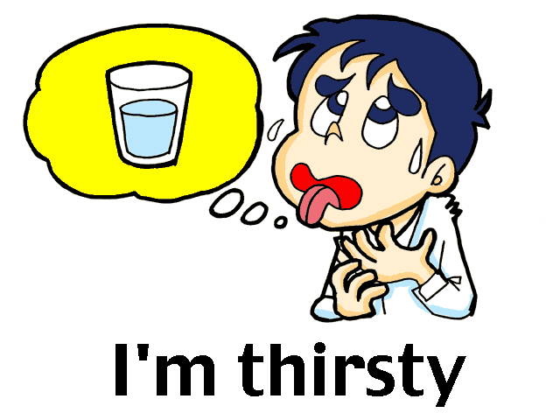
haus
I know what you’re thinking … “haus” must be the Indonesian word for “house” , right? WRONG !!!
In Indonesian, “haus” means “thirsty”!

Slide 4
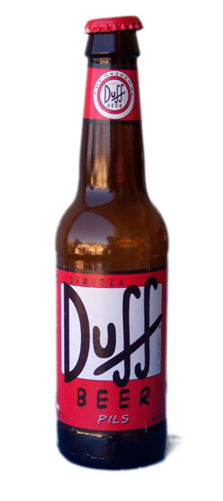
haus
Hey, Moe. Gimme a bottle of Duff Beer!
This one’s on the “haus” , Homer!

Slide 5
haus

Slide 6
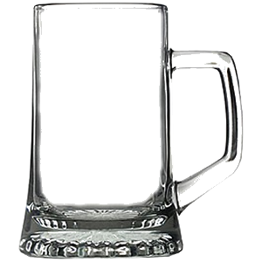
haus
Don’t be a dummy like Homer … if you’re “haus” , just drink up!

