Slide 2
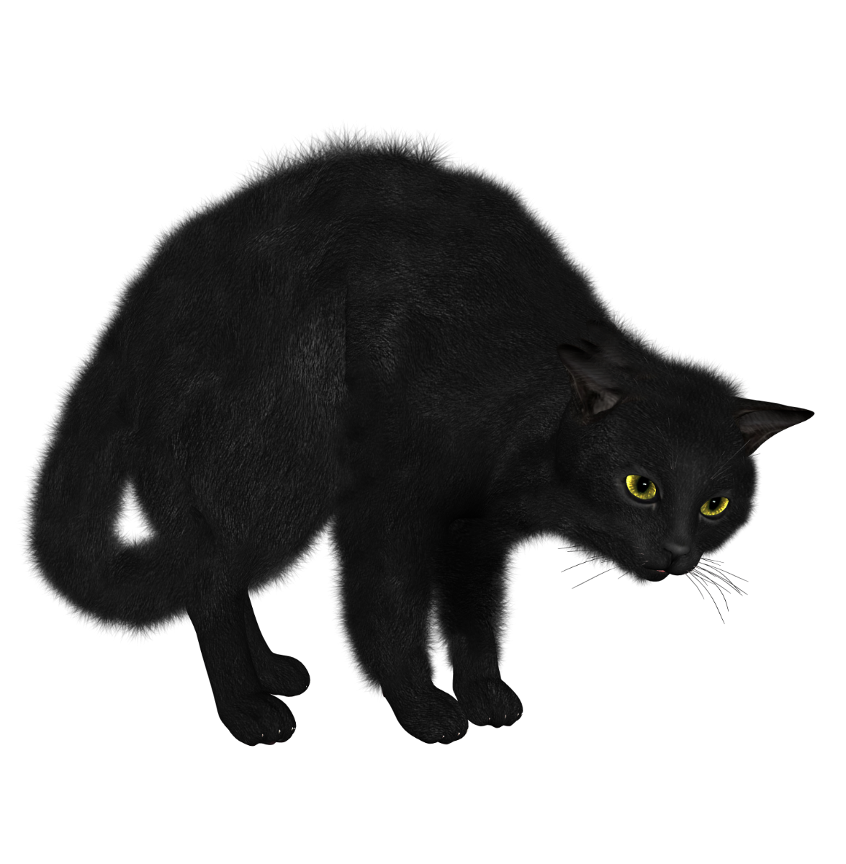
harimau

Slide 3
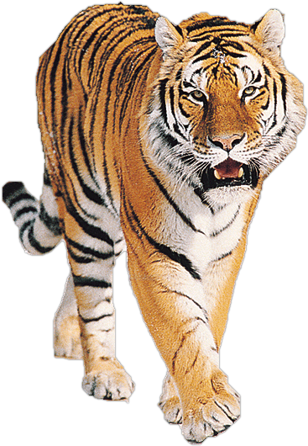
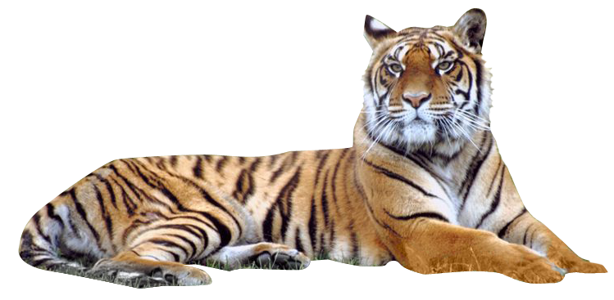
harimau
You are probably thinking that “harimau” means “Harry Potter’s cat”, right? This time you’re almost half way there!
“harimau”, pronounced “hah-rie-mah-oo”, is the Indonesian word for “tiger”, which, after all, is just a big cat!

Slide 4
harimau
You may also remember that “mau”, pronounced “mah-oo”, means “want”, so another way to remember the word for “tiger” is to translate “Harry wants …” which becomes “Hari mau …”.
“Saya mau harimau!”

Slide 5
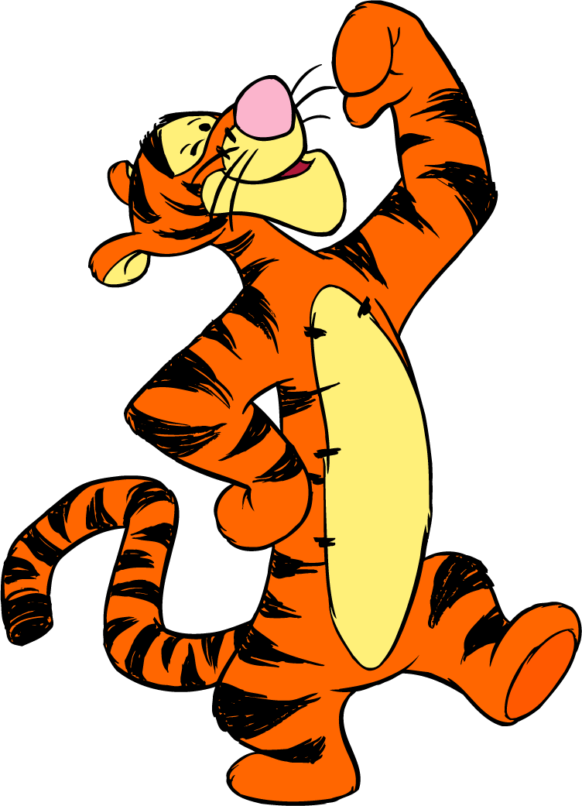
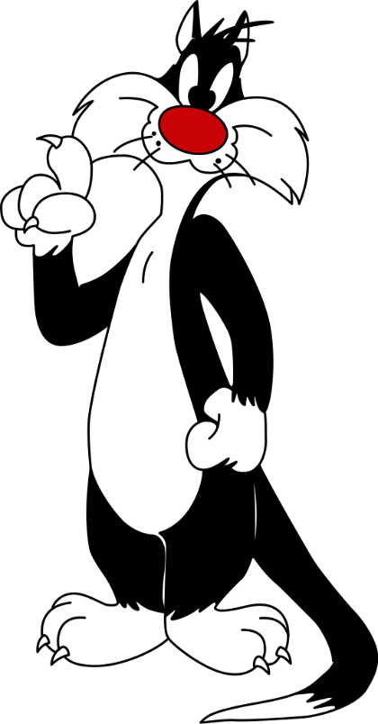
harimau
When it comes to Indonesian, are you a “harimau” or just a “kucing” ?
You have to earn your stripes to succeed in Indonesian!

