Slide 2
got

Slide 3
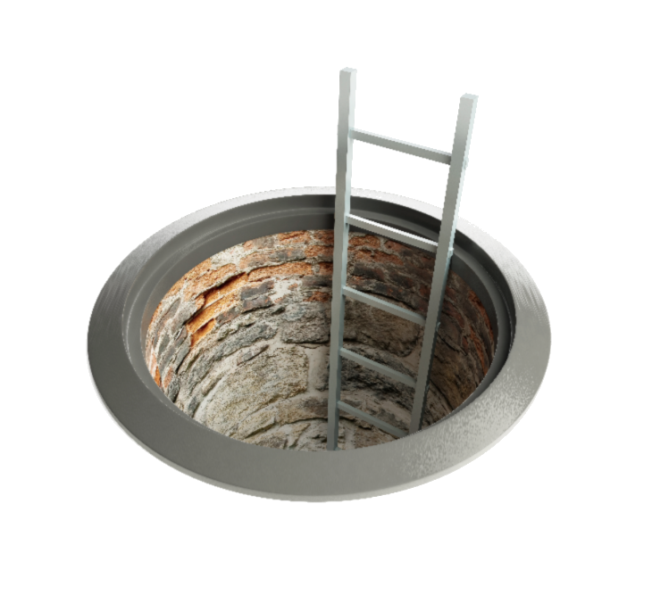
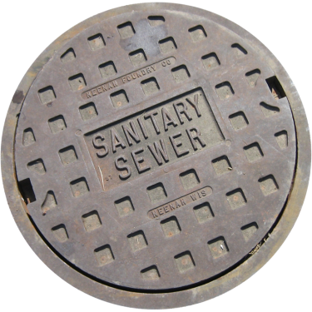
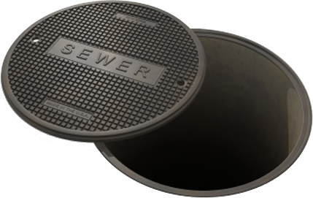
got
I’ll bet you’re thinking that “got”, pronounced “got”, means “to have”, or is the abbreviation for “Game of Thrones” (GoT) in Indonesian, right?
Well, you’re wrong, so I’ve “got” you there!
The noun “got” actually means “sewer” in Indonesian.

Slide 4
got
As a legacy of Dutch colonisation, Indonesia has not “got” deep underground sewerage networks like we have in Australia. They rely more on large, wide open sewerage canals or drains located under footpaths.
A common problem in Indonesia is that people tend to fall into these drains when a slab of concrete footpath goes missing. So, you’ve “got” to be careful when walking poorly-lit streets at night in Indonesia or you might find yourself up to your neck in #*IT !!!

Slide 5
got
In Indonesia, you cannot “sewer” local government authority in court for damages if you fall into a “got”. The judge would simply say, “You’ve ‘got’ to be more careful !”
Next time, you’ve “got” to watch your step! Case dismissed!

