Slide 2
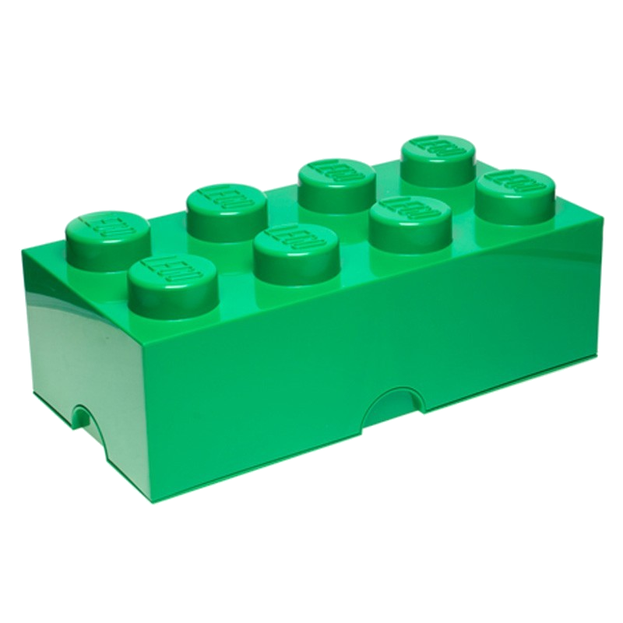
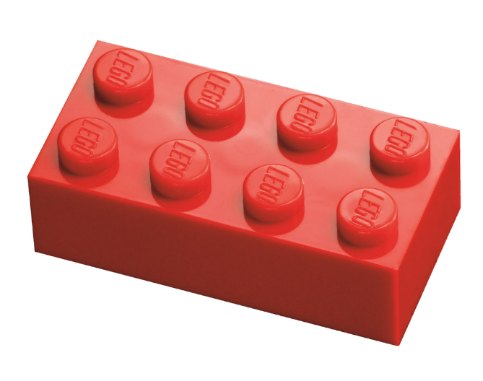
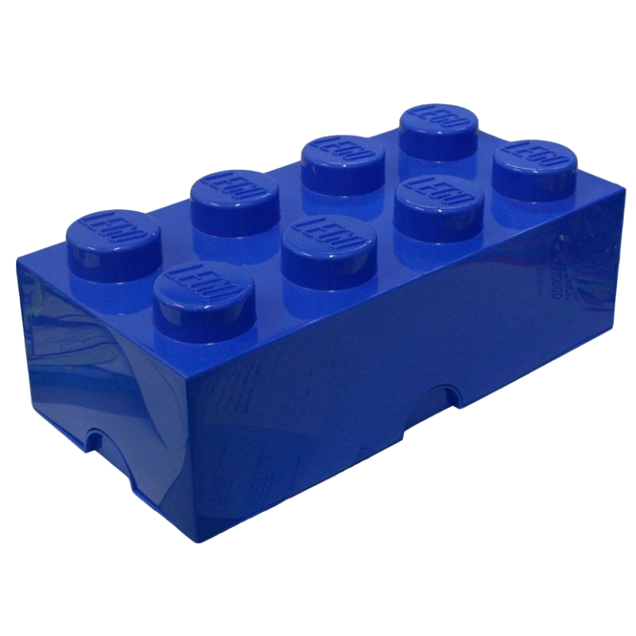
goblok

Slide 3
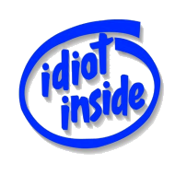
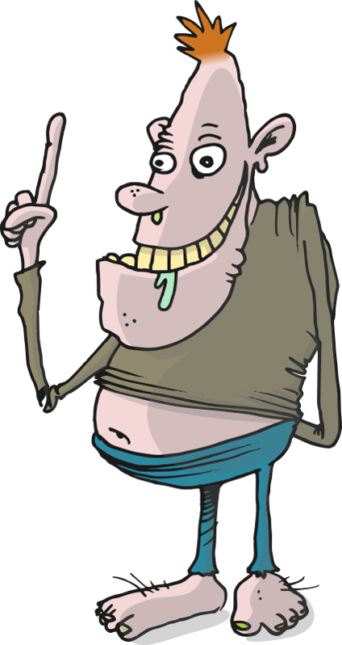
goblok
You are probably thinking that “Go Block” is the new advertising slogan for Lego, right?
Sorry to disappoint you, but “goblok” , pronounced “gor-block”, means “idiot” in Indonesian.

Slide 4
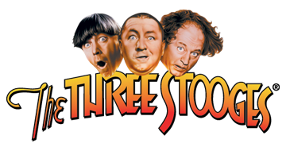
goblok
There have been many famous knuckleheads or “goblok-goblok” in history but few can surpass The Three Stooges.

Slide 5
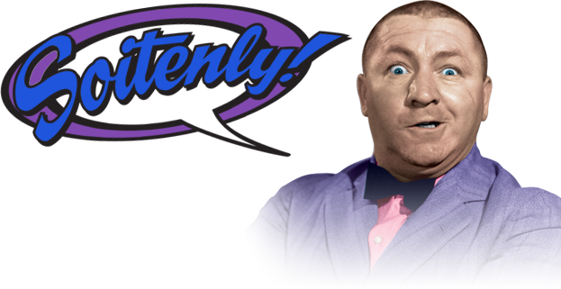
goblok
Just ask Curly ... I’m ‘soiten’ he’ll agree!

