Slide 1
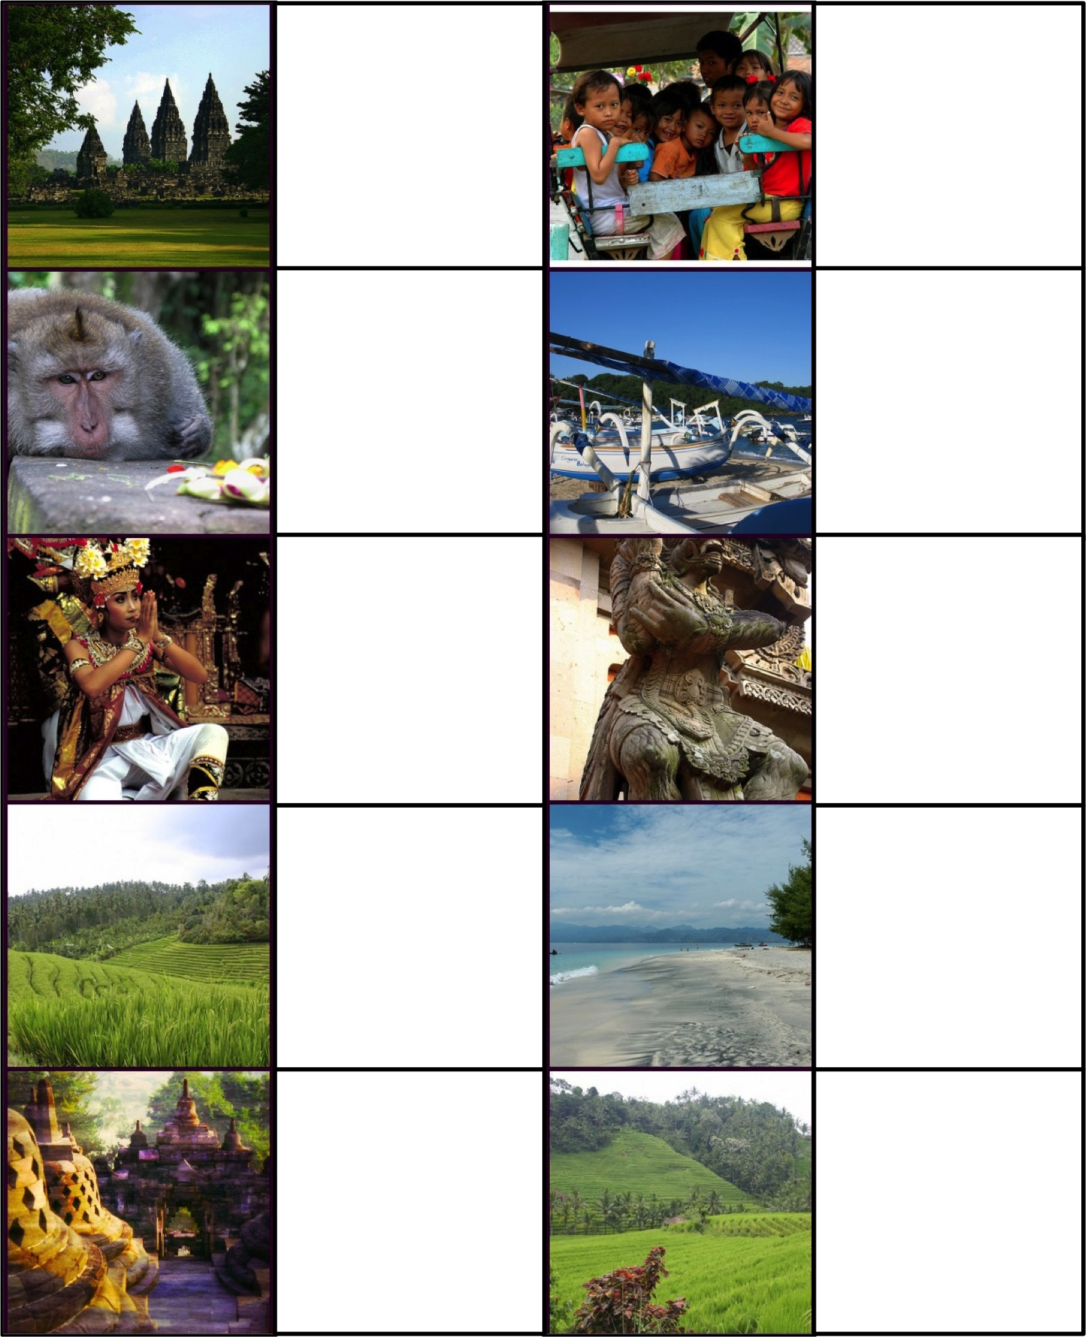
Exit Slips
Adapted by Penny Coutas
Images by robynejay http://www.flickr.com/photos/learnscope/2611666172
How could you use today’s lesson in real life?
Dua frasa baru hari ini:
1.
2.
Briefly summarise what you learned today:
3 kata baru hari ini:
1.
2.
3.
Today, I learned…
What was unclear in today’s lesson?
The thing that surprised me the most today was...
Besok, saya akan…
Today’s lesson
:) was good
:| was so-so
x| occurred while I was sleepy
:o was boring
:( wasn’t what I needed
Explain why:
Hari ini, saya kurang mengerti…

Slide 2
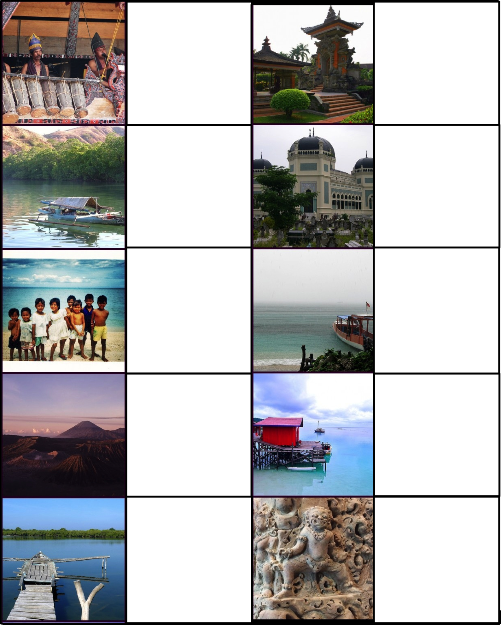
The thing that surprised me the most today was…
Saya suka…. hari ini.
Lalu? What should we do next?
Saya ingin…
How could you use today’s lesson in real life?
Tolong jelaskan…
Please explain more about…
Tolong! I need help with…
Write one question you have about today’s lesson:
I would like to learn about…
The best part of class today was…

Slide 3
Gimme Five!
Adapted by Penny Coutas
Images by robynejay http://www.flickr.com/photos/learnscope/2611666172
Five things you have done well this lesson
1.
2.
3.
4.
5.
Five things you have done well this lesson
1.
2.
3.
4.
5.
Five things you have seen other members of the class do well
1.
2.
3.
4.
5.
Five things you have seen other members of the class do well
1.
2.
3.
4.
5.
Five things you know now, but didn’t know at the start of the lesson
1.
2.
3.
4.
5.
…
Five things you know now, but didn’t know at the start of the lesson
1.
2.
3.
4.
5.
…
Five things you would like to find out more about
1.
2.
3.
4.
5.
Five things you would like to find out more about
1.
2.
3.
4.
5.
Five things students could improve next lesson
1.
2.
3.
4.
5.
Five things students could improve next lesson
1.
2.
3.
4.
5.

