Slide 2
damai

Slide 3
damai
You’re probably thinking that “damai”, pronounced “dumb-eye”, means “dummy” or “idiot” in Indonesian, right? Incorrect … the word for “idiot” is “goblok”!
The noun “damai” actually means “peace” in Indonesian.

Slide 4
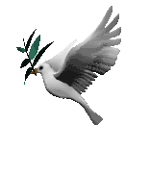
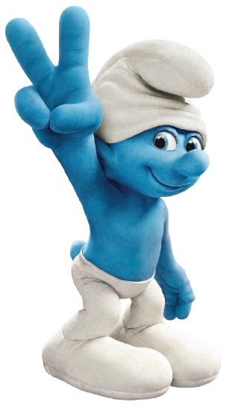
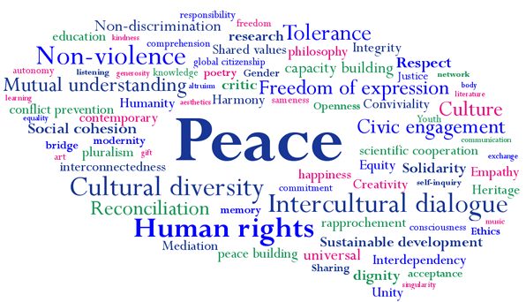
damai
All the trouble in the world has me questioning, “Where is the love?”

Slide 5
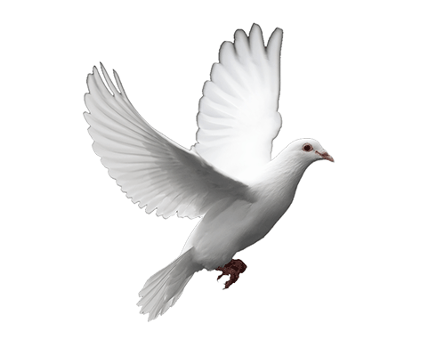
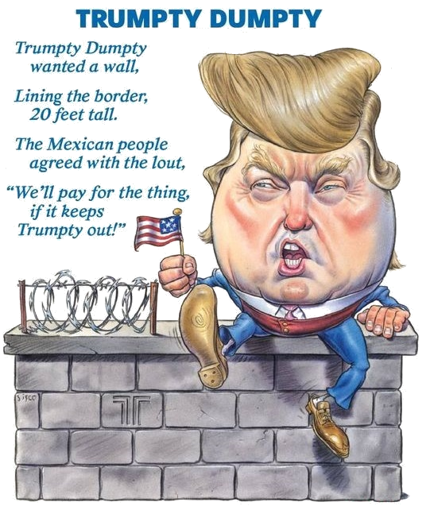
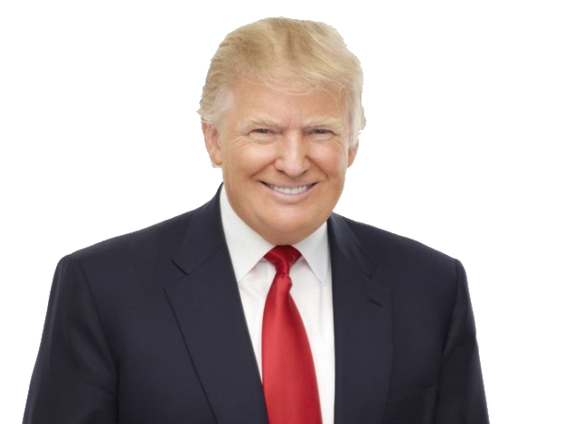
damai
One way of making the world more “damai” is by having leaders who build bridges, not walls!

