Slide 2
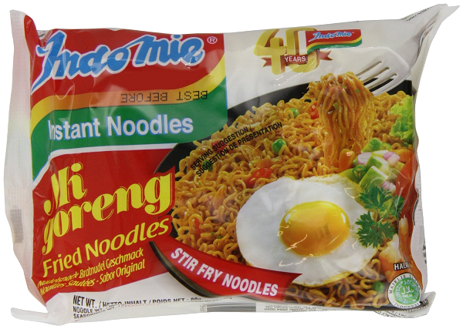
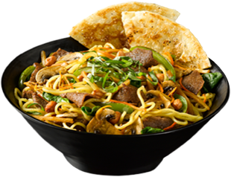
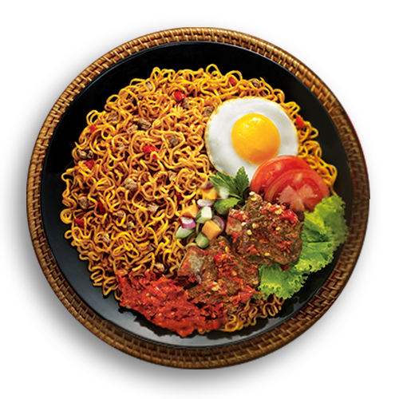
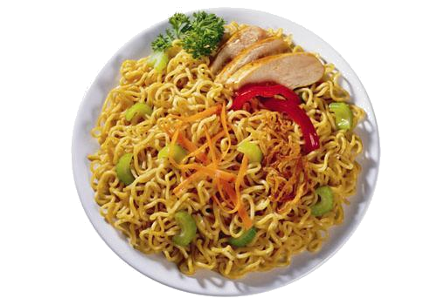
cumi-cumi

Slide 3
cumi-cumi
In a previous WOTD you already learnt that “mi” is the word for “noodles” in Indonesian. Do you remember “mi”???
It is then only logical to assume that “cumi-cumi”, pronounced “chew-me chew-me”, means to “continually chew on noodles”, right?
Sorry to disappoint you, but “cumi-cumi” has nothing at all to do with the chewing of noodles or of anything else!

Slide 4
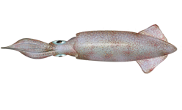
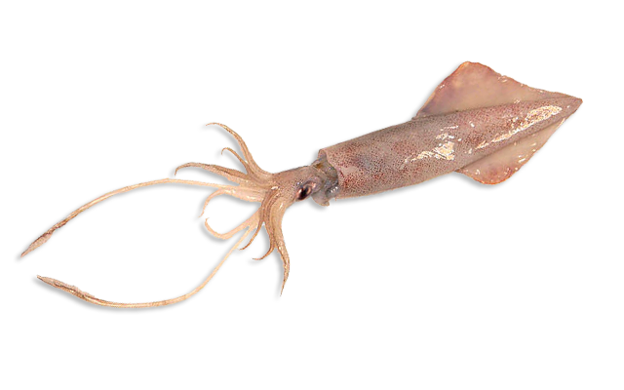
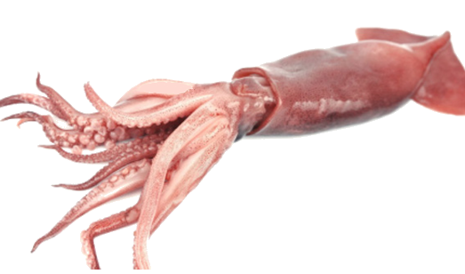
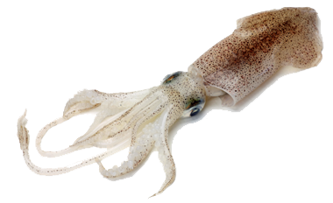
cumi-cumi
In actual fact, the noun “cumi-cumi” means “squid” in Indonesian.
It’s difficult to imagine how I could possibly have evolved from such a simple life form!!!

Slide 5
cumi-cumi
Indonesians enjoy a wide variety of tasty “cumi-cumi” dishes.
If you don’t fancy eating “cumi-cumi” , take in a streaming Indonesian video at cumicumi.com instead!

