Slide 2
cin-cin

Slide 3
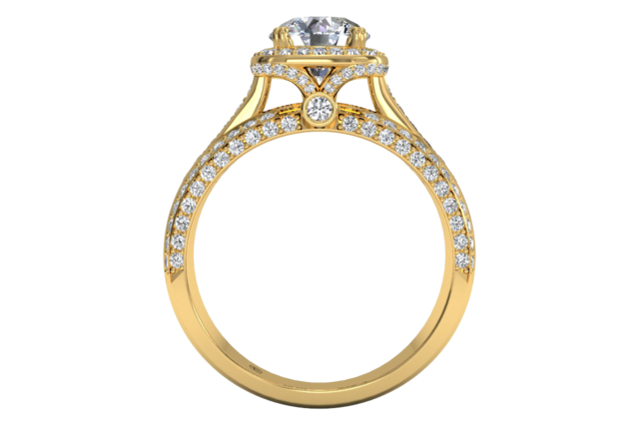
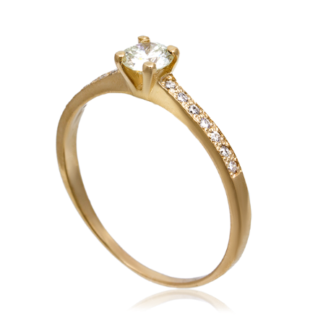
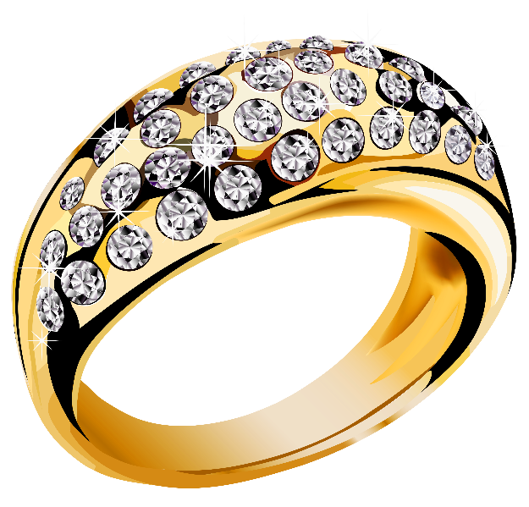
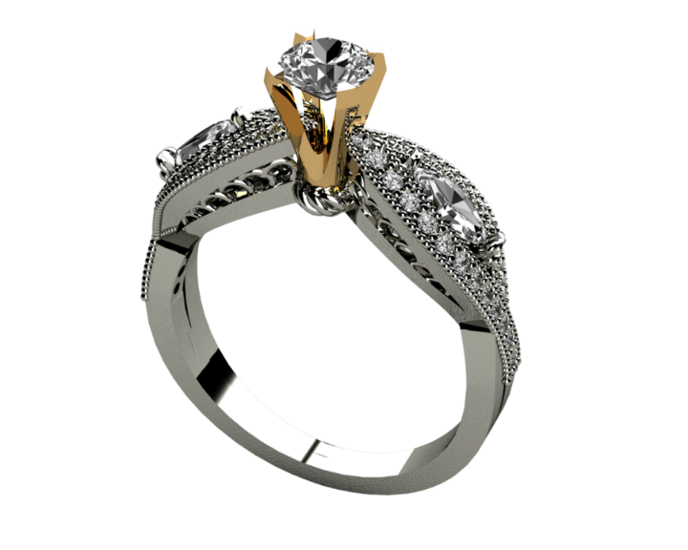
cin-cin
The Indonesian noun “cin-cin”, pronounced “chin-chin”, is not a double chin as suggested by the picture on the previous slide.
A “cin-cin” is a “ring” that one wears on the finger.

Slide 4
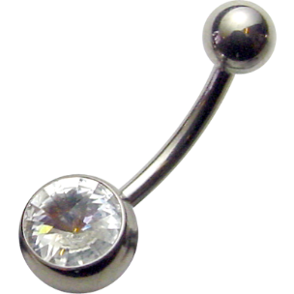
cin-cin
If you were to wear chin piercing on your double chin, you could say that you had a “chin cin-cin” !

