Slide 2
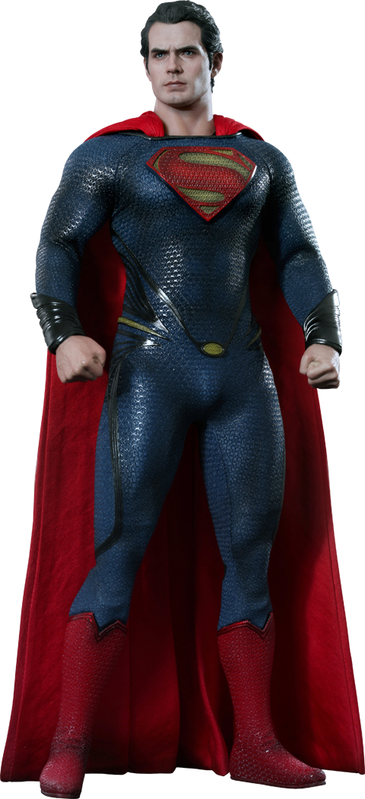
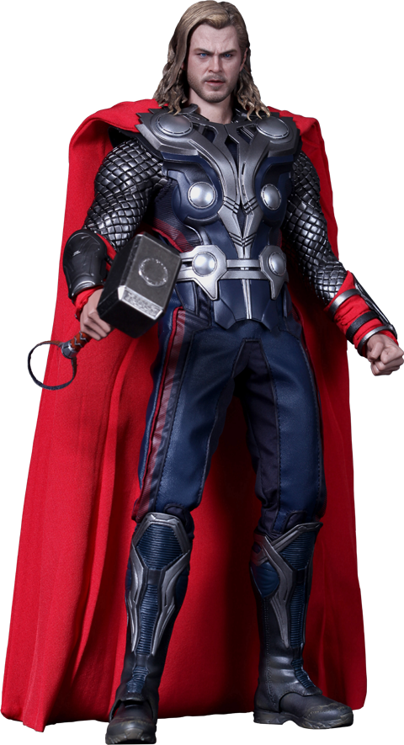
cape

Slide 3
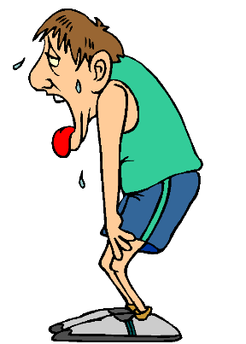
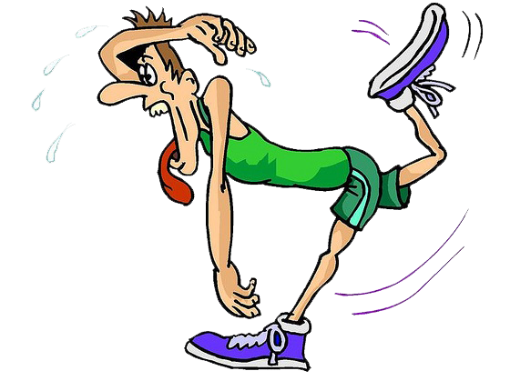
cape
I’ll bet you’re thinking that “cape”, pronounced “char-peh”, means “cape” in Indonesian, right?
Considering you’re no superhero, it should come as no surprise that you are wrong yet again.
The adjective “cape” means “tired” in Indonesian.

Slide 4
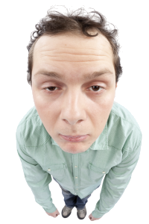
cape
Frankly, the whole idea of dressing up in a colourful “cape” and working around the clock to solve the world’s problems make me feel “cape”!

