Slide 1
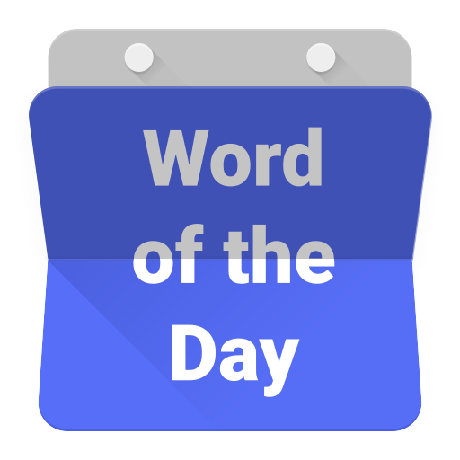

Slide 2
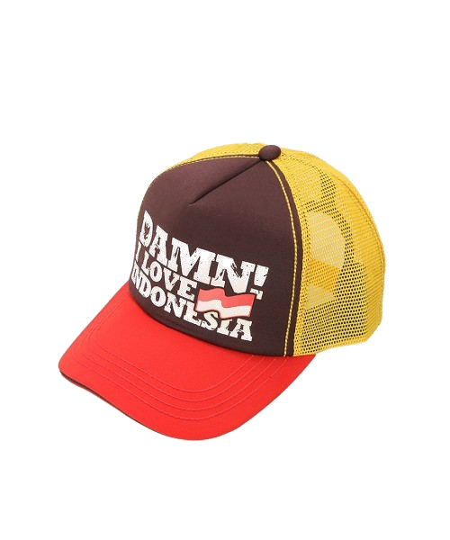
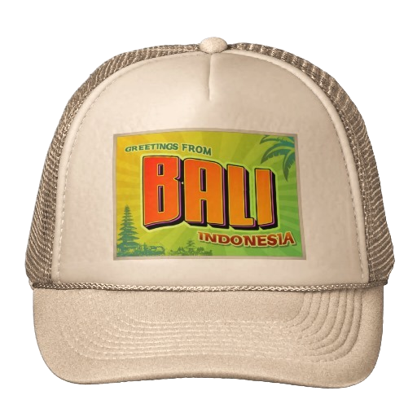
cap

Slide 3
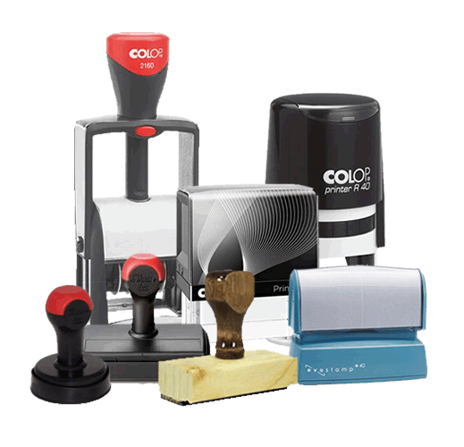
cap
I suppose you’re thinking that “cap”, pronounced “chup”, means “cap” in Indonesian … after all, it is spelt exactly the same way!
Be a good “chap” in accepting that the noun “cap” is an ink stamp in Indonesian.

Slide 4
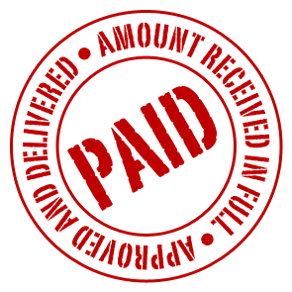
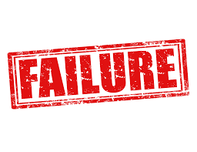
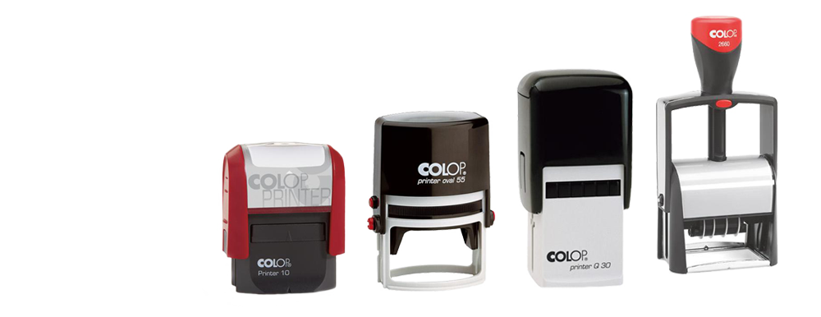
cap

Slide 5
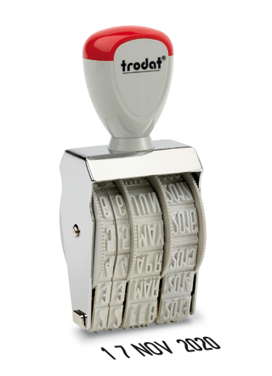
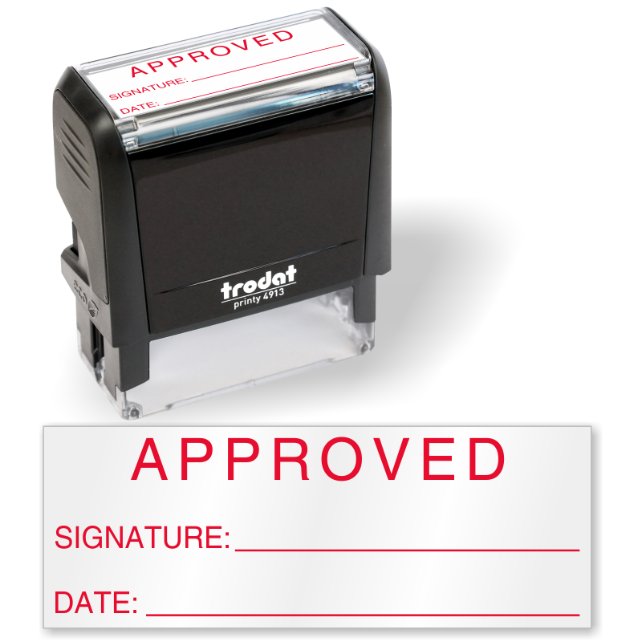
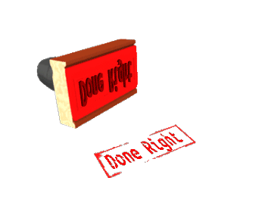
cap
I am sure we are all in agreement that Word Of The Day will the receive stamp of approval for the foreseeable future!

