Slide 2
campur

Slide 3
campur
I know you must be thinking that “campur” must be the Indonesian word for “camper” or “camping” , right?
Sorry to disappoint you, but “campur”, pronounced “chum-pour”, means “to mix” or “mixed” .
“Nasi Campur” or “Mixed Rice” is a favourite dish throughout Indonesian with each region having its own unique variation.
To see some of these regional delicacies, go to the next slide.

Slide 4
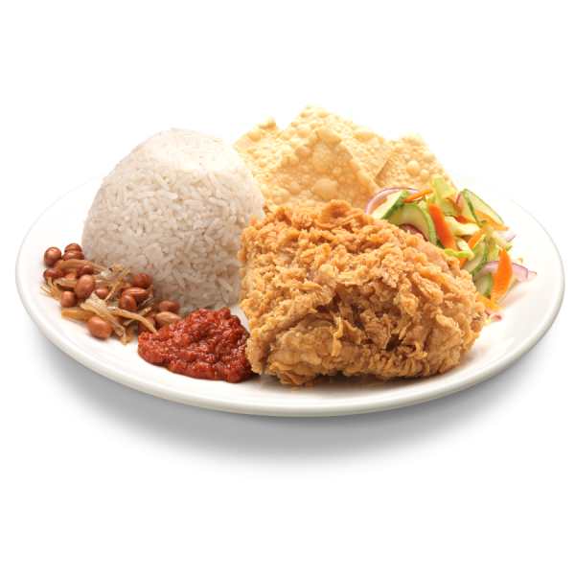
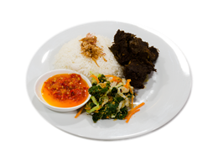
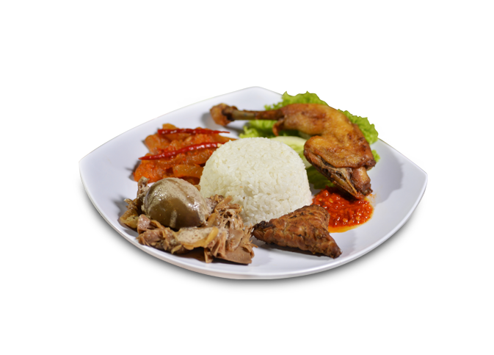
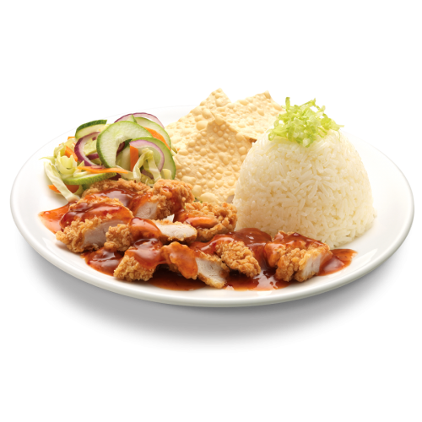
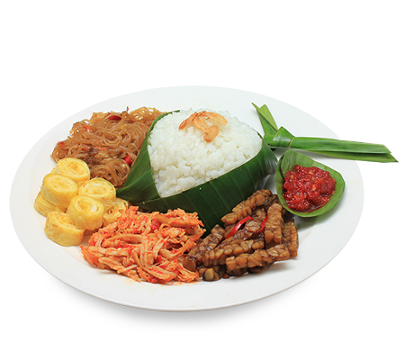
nasi campur

Slide 5
campur
I’ll bet you’re all mixed-up about which dish you’d like to eat !

