Slide 2
buang air

Slide 3
buang air
You still remember that “air”, pronounced “eye-ear”, means “water”, don’t you?
The word “buang”, pronounced “boo-ung”, means to “throw out” or “dispose of” something.
Therefore, it would be logical to assume that “buang air” means to “throw out the water”, wouldn’t it?

Slide 4
buang air
WRONG!!!

Slide 5
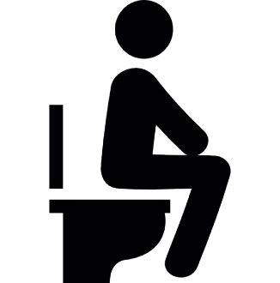
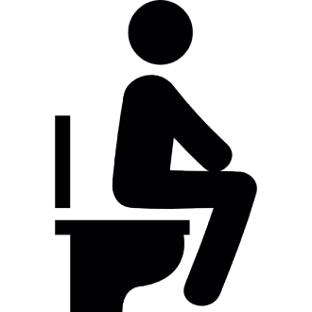
buang air
In Indonesian, “buang air” is the polite way of saying you need to go to the toilet: “Saya mau buang air!”
However, to complicate matters, there are two types of water that Indonesians like to “buang” in the toilet … the “big water” and the “small water”.
For clarification, please go to the next slide!

Slide 6
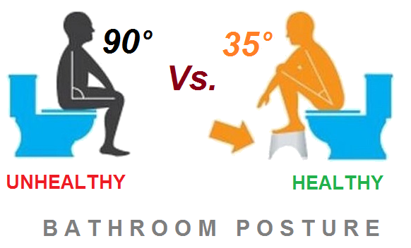
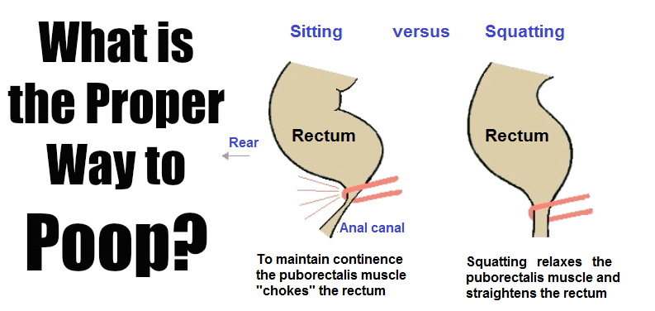
buang air besar
“buang air besar” is the polite way of saying you need to “throw out the big water” or “defecate”: “Saya mau buang air besar!”

Slide 7
buang air kecil
“buang air kecil” is the polite way of saying you need to “throw out the small water” or “urinate”: “Saya mau buang air kecil!”

Slide 8
buang air
It would appear that Indonesia, and most other Asian nations, have turned going to the toilet into a precise practice based on sound medical science!
In contrast, for us Westerners, it is more of a “hit and miss” exercise.

