Slide 2
buah

Slide 3
buah

Slide 4
buah
No, “buah” does not mean “ghost” or “scared”!
The noun “buah”, pronounced “boo-ah”, means “fruit” in Indonesian.
The only thing you would need to worry about with Indonesian fruit is being hit on the head by a falling coconut!

Slide 5
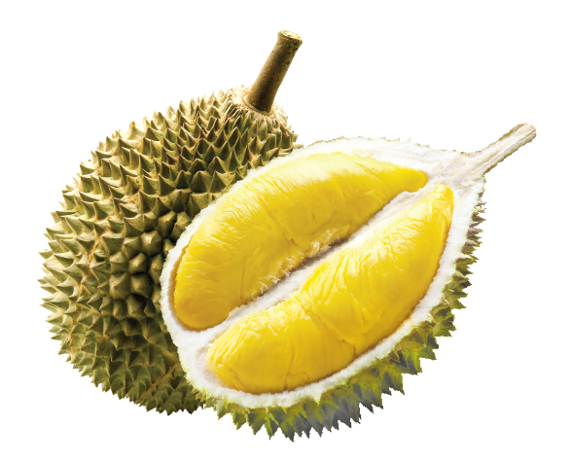
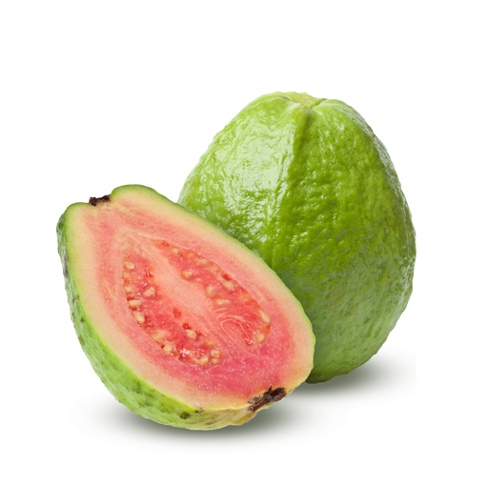
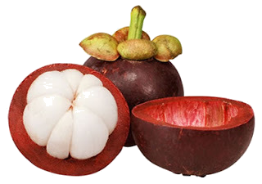
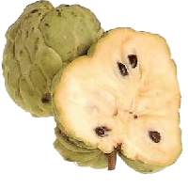
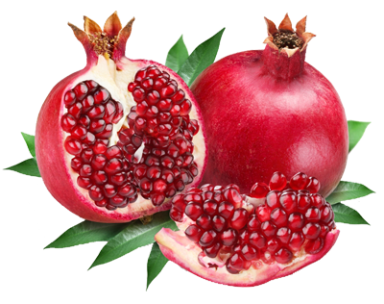
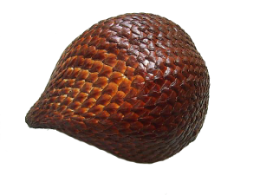
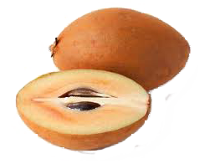
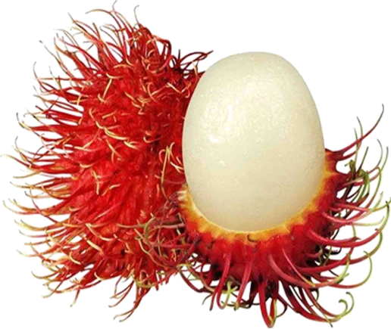
buah
Indonesians enjoy a wide range of delicious tropical fruit that are not common in Australia. Here are a few!

