Slide 2
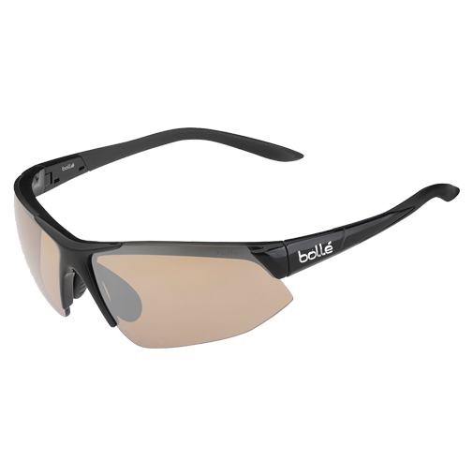
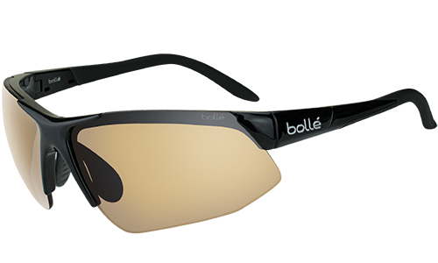
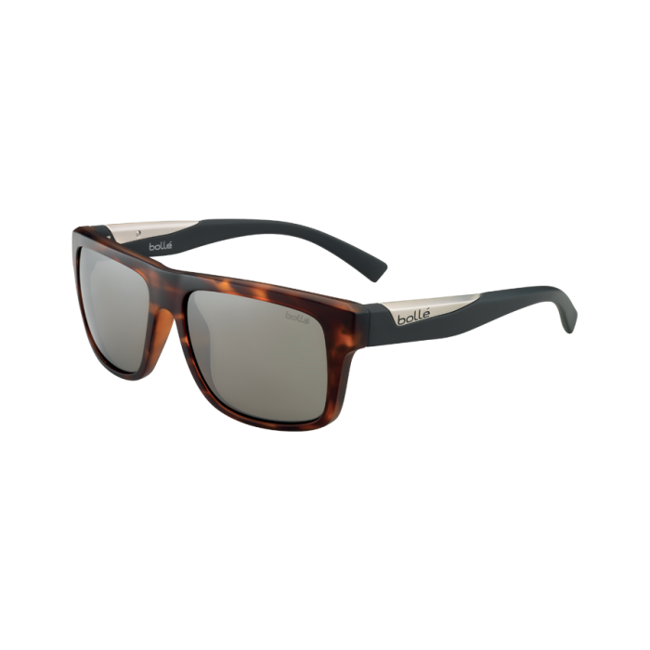
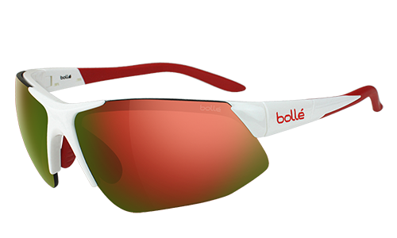
boleh

Slide 3
boleh
No, “boleh” , pronounced “boh-lay”, is not the Indonesian name for the world-famous fashion eyewear brand.
“boleh” means “may” in Indonesian.
It is used both to ask “May I … ?” questions (“Boleh saya …?”) and to answer these questions (“Ya, boleh!” or “Tidak boleh!”).

Slide 4
boleh
Don’t make a habit of asking to go to the toilet too often during your Indonesian classes because the reply just might be “tidak boleh!”
Tidak boleh, SIMPSON! Kembali ke kelas!!!
Boleh saya ke WC, Pak Skinner?

