Slide 2
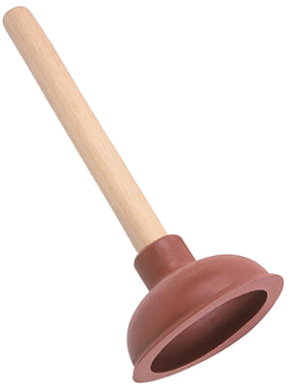
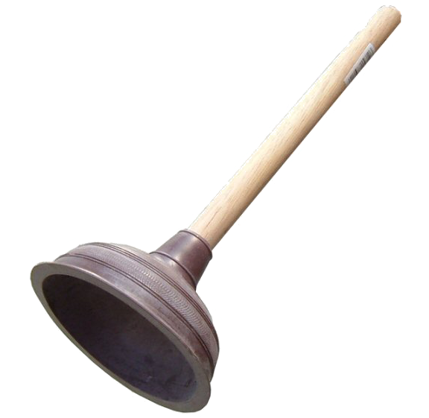
blokir

Slide 3
blokir
I know that you’re probably thinking that “blokir”, pronounced “block-ear”, means a “blocked ear” in Indonesian! This time you are partly correct!
The Indonesian verb “blokir” means “to block” or “restrict access” to something.

Slide 4
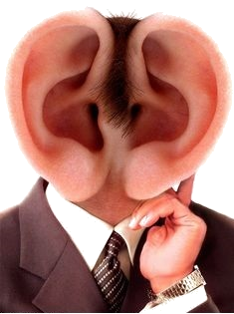
blokir
Learning Indonesian is good for your brain function.
Don’t deny your brain access to rich daily stimulus by attempting to “blokir” the WORD of the DAY !!!
I’m all ears!

