Slide 2
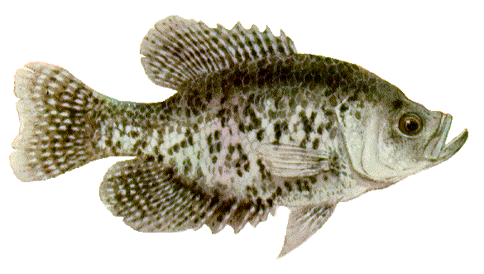
berisik

Slide 3
berisik
Hold on a minute … I said “berisik” (noisy) - not “bersisik” (scaly), so get rid of the fish and find other images !!!
“berisik” is an adjective meaning “noisy”. The teacher may often say, “Jangan berisik!” which means, “Don’t be noisy!”
Are you “berisik” in class???

