Slide 1
Shopping & Bargaining
The Price Is Right

Slide 2
Tambah

Slide 3
Increase

Slide 4
Mahal

Slide 5
Expensive

Slide 6
Harga Pas

Slide 7
Fixed Price

Slide 8
Diskon

Slide 9
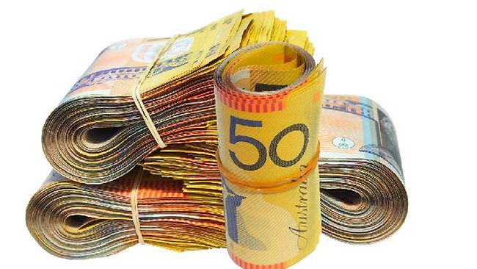
Uang Tunai

Slide 10
Cash

Slide 11
Kurang

Slide 12
Decrease

Slide 13
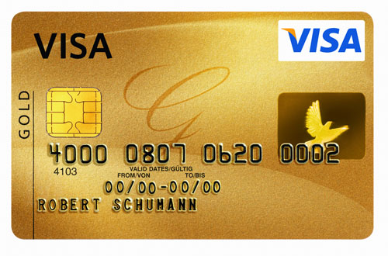
Kartu Kredit

Slide 14
Credit Card

Slide 15
Murah

Slide 16
Cheap

Slide 17
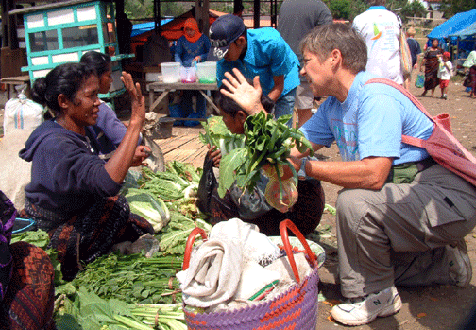
Tawar

Slide 18
Bargaining

