Slide 2
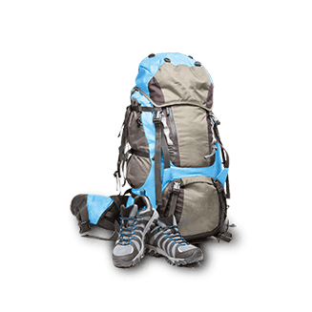
bapak

Slide 3
bapak
How many times do I have to tell you, it’s “bapak”, not “backpack”, so spell it correctly!
In Indonesian “bapak”, which is pronounced “bah-puck”, means “father” or “Mr.”.
To meet the world’s favorite “bapak”, go to the next slide.

Slide 4
bapak
Yes, it’s Homer Simpson! He may not be carrying a backpack on his back, but he has a few extra kilograms around the waist!

