Slide 2
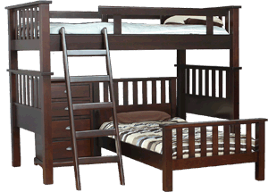
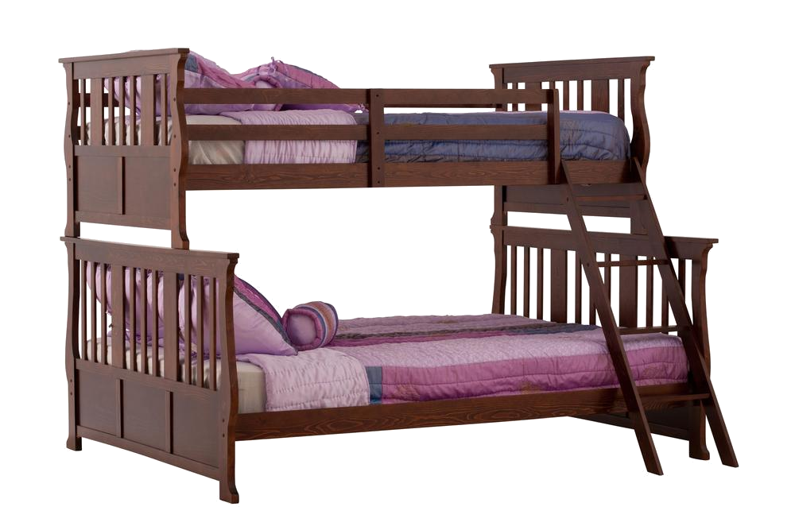
bank

Slide 3
bank
“bank” , pronounced “bunk”, is not the Indonesian word for “bunk bed”! It is, in fact, the Indonesian word for “bank”!
As the names of our banks are actually adjectives, they are placed after the word “bank” in Indonesian, for example, “Bank Commonwealth”.
If you think that’s a lot of “bunk” (nonsense), please proceed to the next slide!

Slide 4
bank
Your money is safer in the “bank” than under the “bunk”!
You can also bank on the fact that there will be another WORD of the DAY tomorrow, even if the interest rate is low!

